Slide 1

Electric Two-/Three-Wheeler Solutions
Transportation

Slide 2
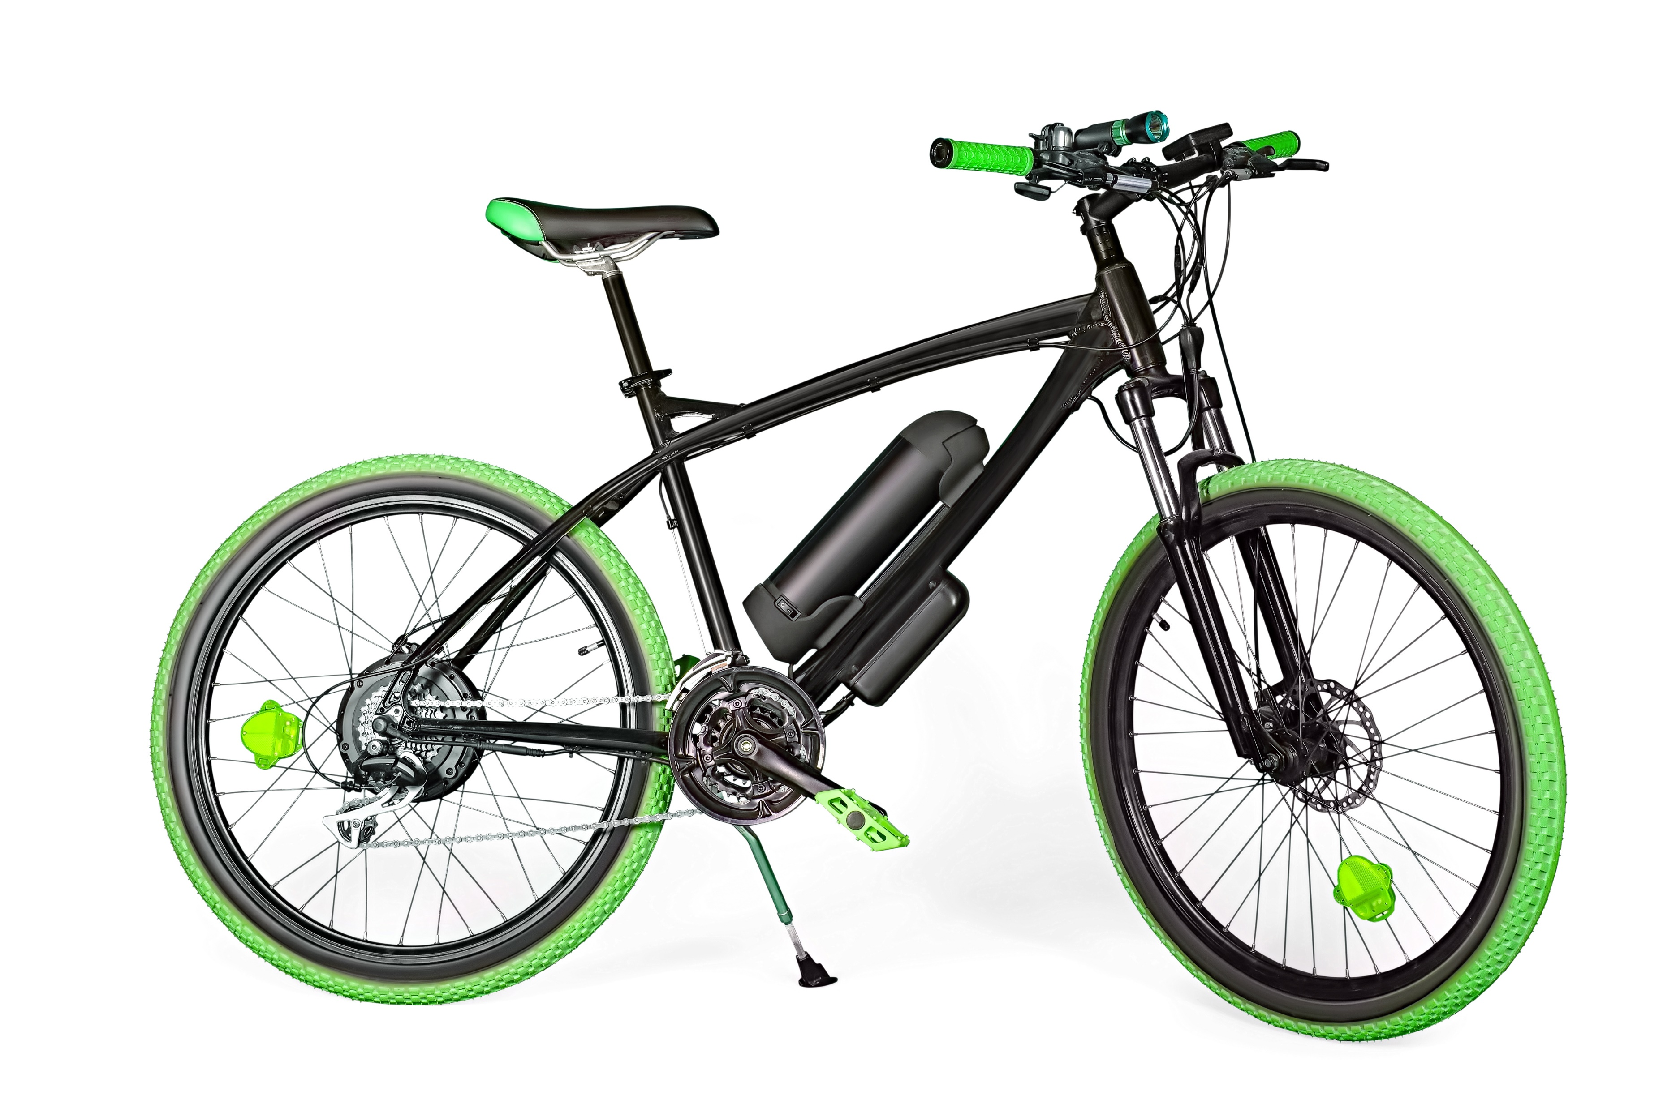
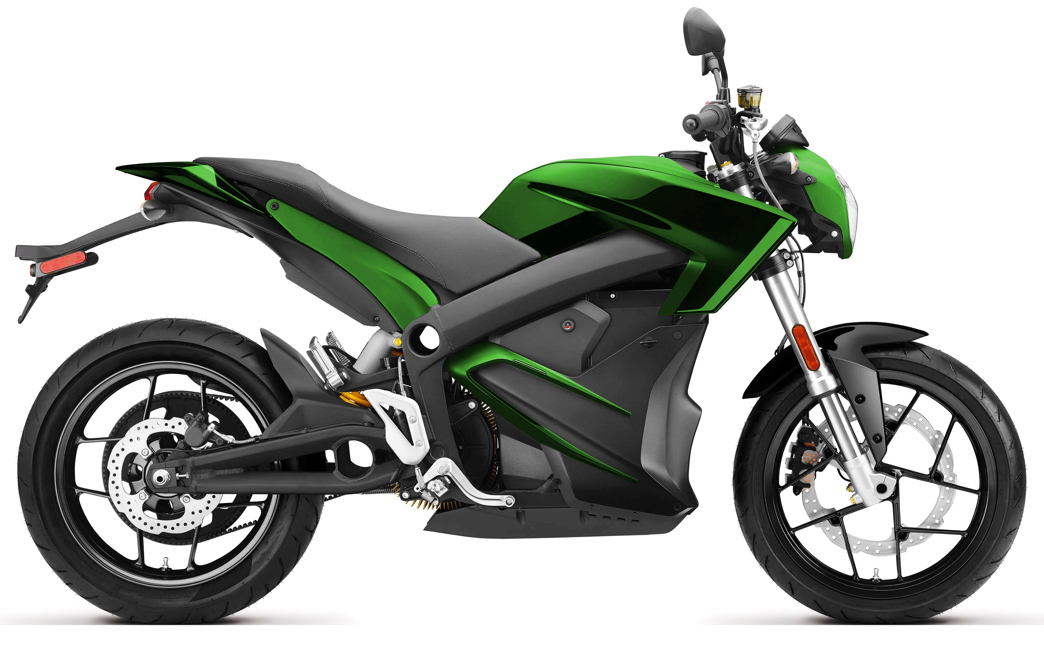
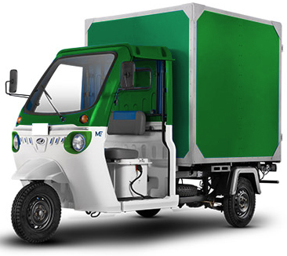
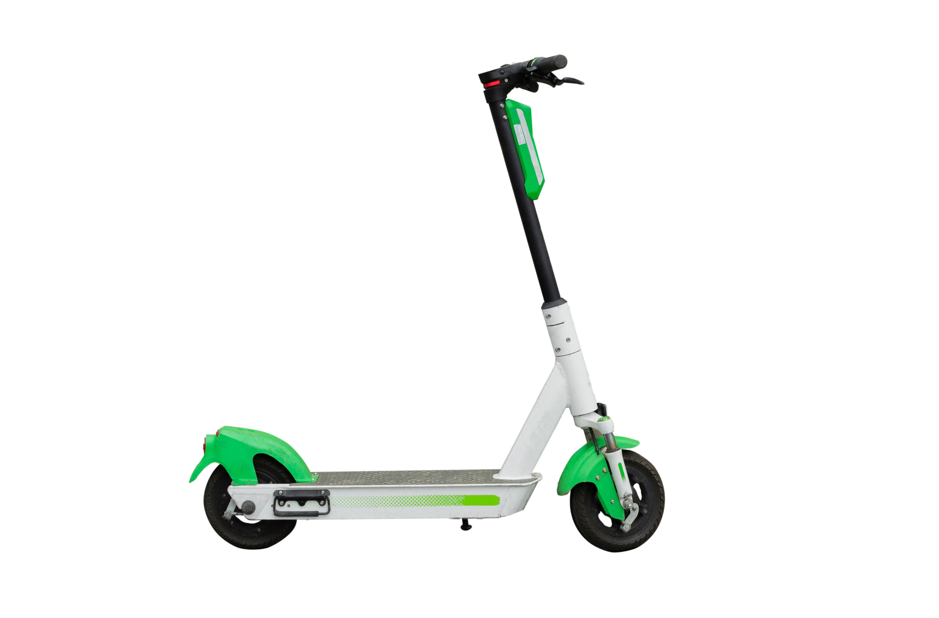
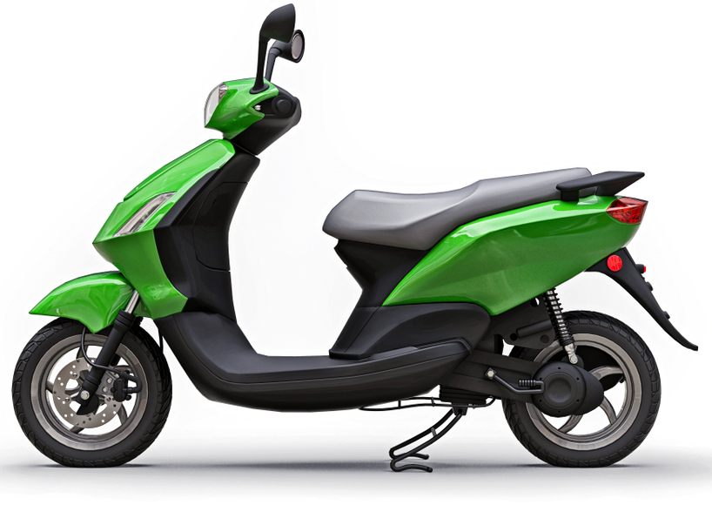

By fulfilling many zero-emission mandates, electric two-/three-wheelers help improve air quality
Battery Capacity
500 Wh
1,000 Wh
3,000 Wh
5,000 Wh
7,000 Wh
10,000 Wh
Electric
Bike
Electric
Motorcycle
Electric
Utility Vehicle
Electric
Scooter
Electric
Two-wheeler
Electric
Three-wheeler
Battery Voltage Range 24–96 V

Slide 3
Electric two- & three-wheeler market trends and drivers
Market trends and drivers
The global electric scooter and motorcycle market is projected to grow from 861 thousand units in 2020 to 5,948 thousand units by 2027, at a CAGR of 31.8%
The electric three-wheeler market is expected to grow from $28.90 billion in 2020 to $32.65 billion in 2027
The global electric two-/three-wheeler Li-ion battery pack market has shown double-digit growth. The limited life cycle and usable capacity are likely to shift the focus from lead acid batteries to lithium-ion batteries
Li-ion batteries are lightweight, which helps maintain the energy to weight ratio of the vehicle
48-volt battery packs comprise the largest share; higher-end models also come with 60-volt and 72-volt battery packs
Asia Pacific is expected to be the largest market. China spent approximately $2.4 billion by till 2020 to improve its charging facility infrastructure
The Indian government has undertaken initiatives such as FAME-II, offering subsidies and tax exemptions to buyers to promote electric two-/three-wheelers
27 European countries have imposed taxes on carbon dioxide emissions related to vehicles
Rapid growth for electric two-wheeler
Source: Data Bridge, MarketsandMarkets, Expert Market Research, Fortune Business Insights

Slide 4
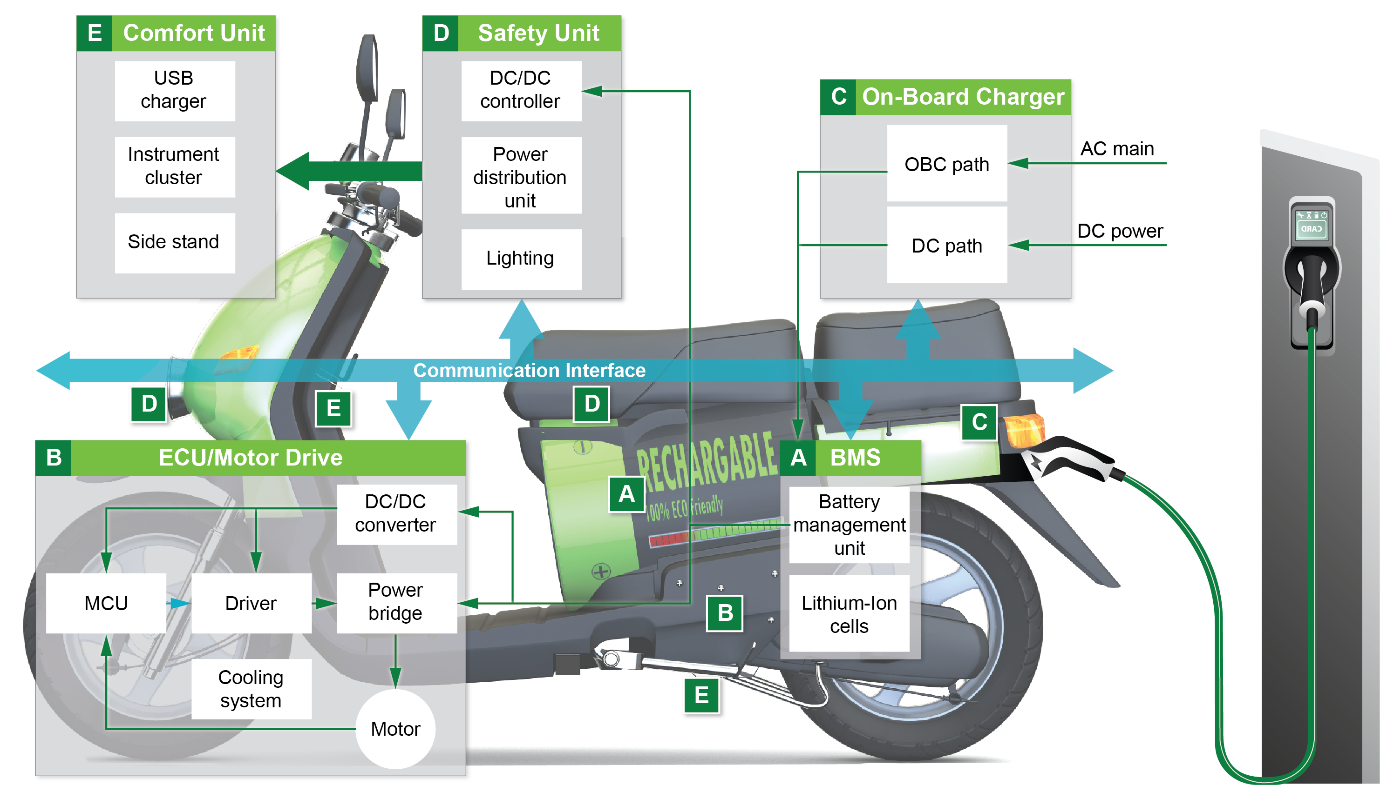
Electric two- & three-wheeler system architecture

Slide 5
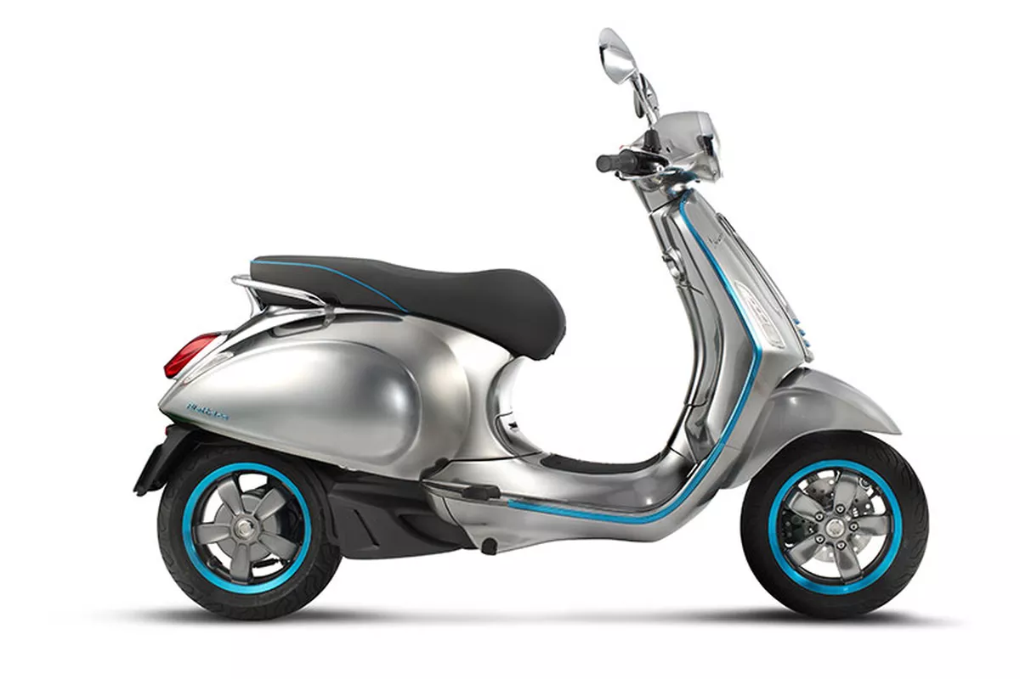
Littelfuse solutions for electric two-wheeler
Comfort Unit
Safety Unit
USB/charging port
● TVS Diode
● PPTC
Lighting
● TVS Diode
● MOV
Cluster
● TVS Diode
● PPTC
Power distribution unit
● Fuse
● Fuse Holder
Side stand
Reed Switch
BMS
● Fuse
● TVS Diode, TVS Diode Array
NTC
Reed Switch
ECU/motor drive
● TVS Diode
MOSFET
Rectifier Diode
Hall Effect
NTC
On-Board charger
● Fuse
● MOV, TVS Diode
● SCR, Diode
● NTC
BMS: Battery Management System
ECU: Engine Control Unit
Protect
Control
Sense

Slide 6
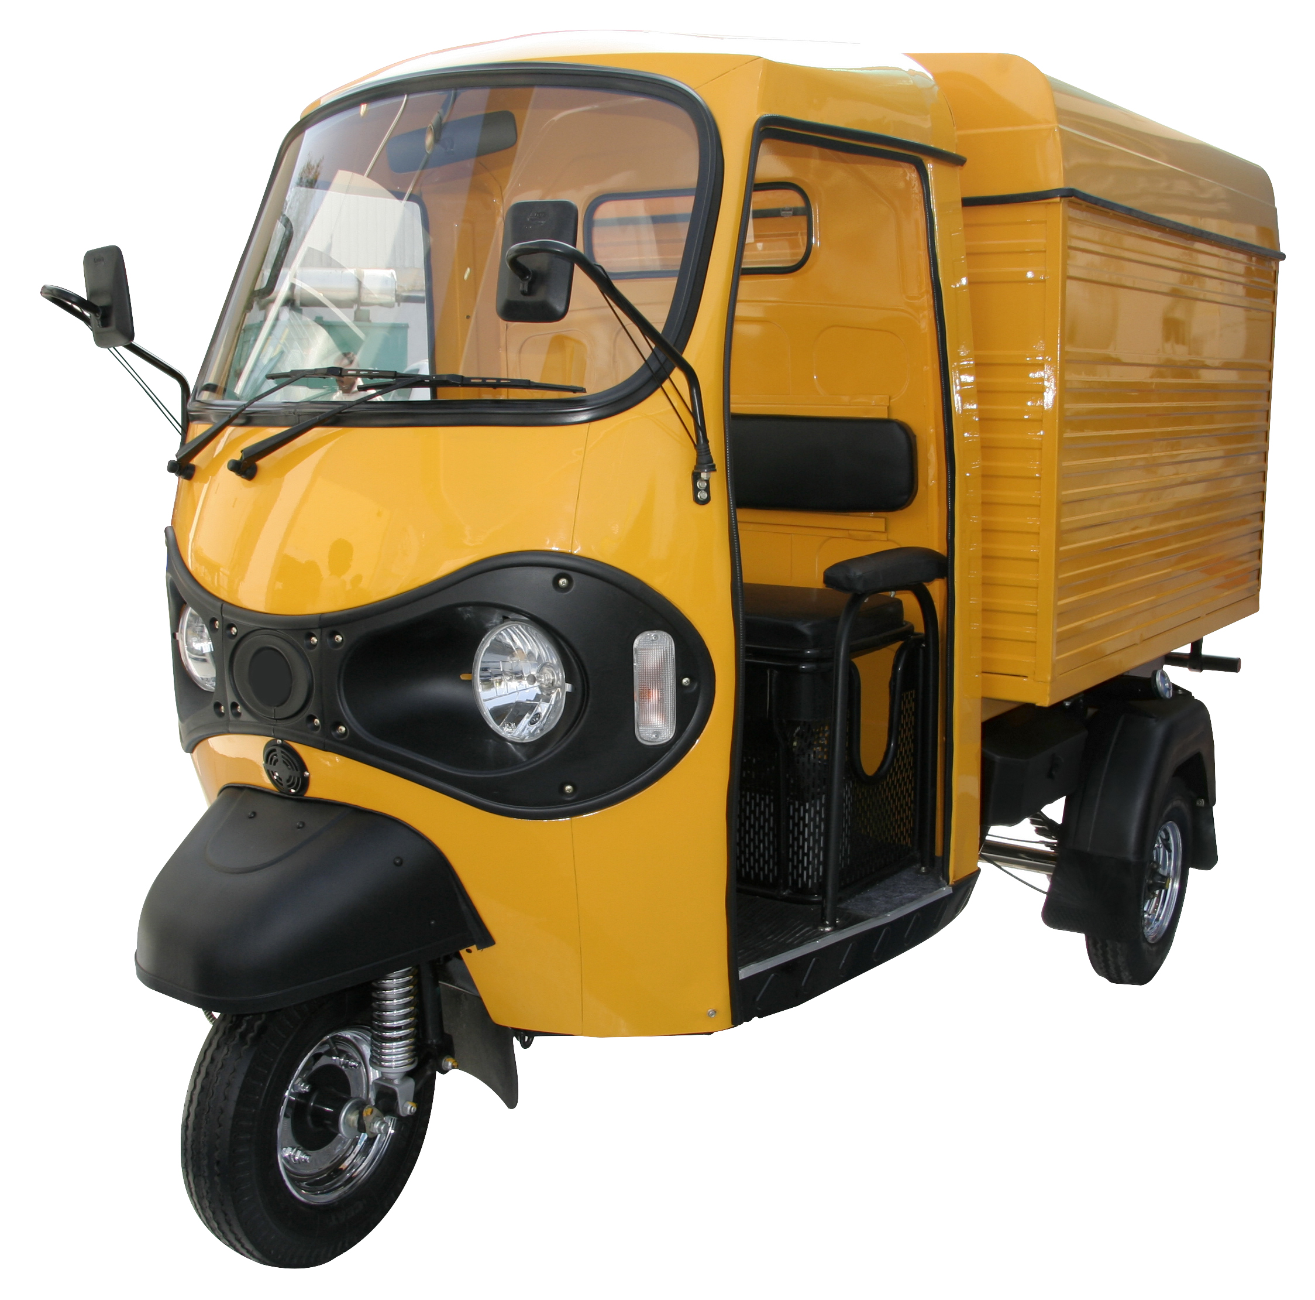
Littelfuse solutions for electric three-wheeler
Lighting
● TVS Diode
● MOV
ECU/motor drive
● TVS Diode
MOSFET
Rectifier Diode
Hall Effect
NTC
Power distribution unit
● Fuse
Fuse Holder
Fuse box
BMS
● Fuse
● TVS Diode
● TVS Diode Array
● NTC, Reed Switch
HV DC Contactor Relay
On-Board Charger
● Fuse
● MOV, TVS Diode
● SCR, Diode
NTC
BMS: Battery Management System
ECU: Engine Control Unit
Protect
Control
Sense

Slide 7

Battery Management System
Click on the product series in the table below for more info
A
 | Technology | Series
1 | Fuse | MIDI 70V, Mega, BF1 32V, 881, LP Jcase, ATO
 | TVS Diode | TPSMB
 | Fuse | 438A, 437A, MINI, 521
 | HV DC Contactor Relay* | DCNEV, DCNLEV
2 | NTC ** | Leaded , Surface Mount
3 | TVS Diode Array | AQ24CANA
4 | Reed Switch | MDSR-10
5 | Solid State Relay *** | CPC1009N
5
Leakage current to chassis
Battery+
Li-ion cells
Battery management unit
Aux output
Thermal
Coupling
Sense lines
To charger
4
2
Battery swapping
Cell protection module
3
I/O
communication
interface
1
* These products are recommended for three-wheeler vehicles **Thermally coupled with Li-ion cells
*** Suitable for high-end two wheelers with V_{bat} > 60 V
Li-ion cells
Battery
disconnect
unit
Battery-
Legend:
Power
Data

Slide 8
Benefits of recommended Littelfuse products
Click on the product series in the table below for more info
 | Technology | Function in application | Product series | Benefits | Features
1 | Fuse | Short-circuit protection; overload circuit protection | MIDI 70V, Mega, BF1 32V, 881, LP Jcase, ATO | Provides safety protection in low- and medium-voltage environments; full range fuses | Bolt down, bladed, and SMD form factors; high breaking capacity; qualified to ISO 8820 standard or new AECQ specification
 | TVS Diode | Suppression of transient voltage | TPSMB | Excellent clamping capability; meets automotive industry standards; fast response time | AEC-Q101 qualified; meets IEC standards for ESD protection and ISO for in-vehicle transient surges
 | Fuse | Protects cells and downstream BMS components from high fault currents due to external shorts | 438A, 437A, MINI, 521 | Excellent temperature stability and performance reliability; compact design; ceramic substrate ensures compatibility with high-temperature environment | Tested to new AECQ specification; fast response to fault current; surface mount device
 | HV DC Contactor Relay | Connect and disconnect battery from main circuitry | DCNEV, DCNLEV | Allows a low-voltage signal to switch the contacts for a high-voltage signal | Wide range of capabilities: can switch from 10’s of amps to 1000’s of amps, and 10’s of volts to 1000’s of volts
2 | NTC | Semiconductor temperature measurement | Leaded , Surface Mount | Allows for high-precision temperature measurement in harsher environments | UL Recognized with ring lug mounting; SM NTCs is in hermetically sealed MELF package suitable for operation up to 220 °C
3 | TVS Diode Array | Protects sensitive electronic ICs from ESD, EFT, and voltage transients | AQ24CANA | Ensures reliability of the equipment without performance degradation of communication lines | AEC-Q101 qualified; meets ESD protection levels specified under IEC 61000-4-2 and ISO 10605; low leakage current and clamping voltage
4 | Reed Switch | Provides the control signal for the battery pack | MDSR-10 | Contamination resistant; compact design | Switches up to 200 Vdc or 0.5 A at up to 10 W, 10¹² Ω insulation resistance
5 | Solid State Relay | Normally open, single pole relay | CPC1009N | Robust operation in a small four-pin package | 1500 V input/output isolation; low drive requirements; no arching

Slide 9
ECU/Motor Drive
Click on the product series in the table below for more info
B
 | Technology | Series
1 | High Current Fuse | 881, MIDI 70V, Mega
 | Low Current Fuse | 438A, 437A
 | PPTC | RXEF, RKEF
 | TVS Diode | TPSMB
2 | Schottky Diode | DST
 | Thermal Protector | HCRTP-mini
3 | MOSFET | X4 Class
 | MOSFET Module | MTI200WX75GD/ MTI145WX100GD
 | Gate Driver | IXD_6xxSI, IX4340NE
 | Temperature Detection | setP™
 | NTC | Surface Mount, USUR1000
4 | NTC | Leaded , Surface Mount
 | Hall Effect Sensor | 55100
5 | TVS Diode Array | AQ24CANA
Battery
pack
2
DC input protection
Reverse polarity power bridge protection
Power bridge
Cooling system
Gate driver
3
Auxiliary power
1
4
Motor
5
Battery
Pack
I/O
communication
interface
MCU
Legend:
Power
Data

Slide 10
Benefits of recommended Littelfuse products
Click on the product series in the table below for more info
 | Technology | Function in application | Product series | Benefits | Features
1 | High Current Fuse | Short-circuit protection; overload circuit protection | 881, MIDI 70V, Mega | Provides safety protection in low- and medium-voltage environments; full range fuses | Bolt down and SMD form factors; high breaking capacity; qualified to ISO 8820/new AEC
 | Low Current Fuse | Protects auxiliary power supply components from high fault currents due to external shorts | 438A, 437A | Excellent temperature stability; compact design | Tested to new AECQ specification; fast response to fault current; surface mount device
 | PPTC | Resettable overload circuit protection | RXEF, RKEF | Resets to normal operation after fault is cleared; saves space due to small footprint | Maximum electrical rating: 60 VDC; operating current up to 15 A; SMD and leaded options
 | TVS Diode | Suppression of transient voltage | TPSMB | Excellent clamping capability; meets automotive industry standards; fast response time | AEC-Q101 qualified; meets IEC standards for ESD protection and ISO for in-vehicle transient surges
2 | Schottky Diode | Rectification and reverse polarity protection in power supply units | DST | Enables the design of high-efficiency power supplies with Trench MOS technology | Ultra-low forward voltage drop; high-frequency operation; small TO-277B package
 | Thermal Protector | Over-temperature thermal protector | HCRTP-mini | Disconnects the circuit from the supply in the event of over-temperature event | Surface mount, can be installed during reflow process, 16 V rated, can break up to 500 A
3 | MOSFET | High switching speed in power supply units | X4 Class | Fast response time and lower heat signature | Low R_{ds (on)}, dv/dt ruggedness
 | MOSFET Module | High switching speed in power supply units | MTI200WX75GD/ MTI145WX100GD | Fast response time and lower heat signature | Low R_{ds (on)}, dv/dt ruggedness
 | Gate Driver | Controls switching MOSFETs | IXD_6xxSI, IX4340NE | Dual outputs provide space efficient design, high immunity to latch-up; rise/fall times <10 ns | Tight tolerance, small form factor; fast thermal response
 | Digital temperature indicator | Protects motor circuit from overheating | setP™ | Auto resets after over-temperature condition is removed; allows for compact design | Resettable; low resistance; compact 0805 outline
 | NTC | Semiconductor temperature measurement | Surface Mount, USUR1000 | Allows for high-precision temperature measurement in harsher environments | UL recognized with ring lug mounting; SMD NTCs is in hermetically sealed MELF package suitable for operation up to 220 °C
4 | NTC | Semiconductor temperature measurement | Leaded , Surface Mount | Allows for high-precision temperature measurement in harsher environments
 | Hall Effect Sensor | Speed measurement of the motor and position detection of the rotor | 55100 | Available in two- or three-wire versions; miniature flange mount design; wide range of sensitivity | Up to 10 kHz switching speed, unaffected by harsh environments, up to 20 billion operations
5 | TVS Diode Array | Protects sensitive electronic ICs from ESD, EFT, and voltage transients | AQ24CANA | Ensures reliability of the equipment without performance degradation of communication lines | AEC-Q101 qualified; low leakage current and clamping voltage

Slide 11
On-Board Charger
Click on the product series in the table below for more info
C
 | Technology | Series
1 | AC Fuse | 10EV**, 526**
 | Thyristor | HS4040xAQx, S8016xA
 | MOV, SIDACtor® | AUMOV P3800FNL
2 | Si/SiC MOSFET | X2 Class LSICMOxx
 | TVS Diode | TPSMB
3 | Si/SiC MOSFET | X2 Class LSICMOxx
 | TVS Diode | TPSMB
4 | Si/SiC Diode | DPG LSIC2SDxx
5 | DC Fuse | 10EV**, 525**
6 | TVS Diode Array | AQ24CANA
7 | TVS Diode | SLD8S, SLD6S, SLD5S
AC
mains
1
2
3
4
5
Input protection rectifier
and filter
Power factor
control
High- frequency converter
and clamp
Step-down trans-
former
Output rectification and filter
Output DC protection
Battery
pack
Signal
line
6
I/O
communication
interface
Feedback and PWM oscillator
MCU
DC
input
7
Input protection
and filter
Relays
* These products are recommended for three-wheeler vehicles
** Please contact Littelfuse sales
Legend:
Power
Data

Slide 12
Benefits of recommended Littelfuse products
Click on the product series in the table below for more info
 | Technology | Function in application | Product series | Benefits | Features
1 | AC Fuse | Short-circuit protection; overload circuit protection | 10EV**, 526** | Provides safety protection in low- and medium-voltage environments; full range fuses | Bolt down and SMD form factors; high breaking capacity; qualified to ISO 8820/new AEC
 | Thyristor | AC/DC rectification | HS4040xAQx, S8016xA | Solid-state switching with no audible noise during operation; enables power efficient operation; compact design | High voltage withstand capability (800 V), high surge capability up to 225 A, solid-state switching eliminates contact bounce
 | MOV, SIDACtor® | Suppression of transient voltage | AUMOV P3800FNL | Ensures the reliable performance of the circuitry, when paired together, offers lower clamping voltage | Wide range of surge current ratings; disk sizes and lead options
2 | Si/SiC MOSFET | High switching speed in power supply units | X2 Class LSICMOxx | Reduces switching and conduction losses; higher efficiency | Low R_{ds(on)}, dv/dt ruggedness
 | TVS Diode | Suppression of transient voltage | TPSMB | Excellent clamping capability; meets automotive industry standards; fast response time | AEC-Q101 qualified; meets IEC standards for ESD protection and ISO for in-vehicle transient surges
3 | Si/SiC MOSFET | High switching speed in power supply units; SiC for speed and efficiency | X2 Class LSICMOxx | Reduces switching and conduction losses; higher efficiency | Low R_{ds(on)}, dv/dt ruggedness
 | TVS Diode | Suppression of transient voltage | TPSMB | Excellent clamping capability; meets automotive industry standards; fast response time | AEC-Q101 qualified; meets IEC standards for ESD protection and ISO for in-vehicle transient surges
4 | Si/SiC Diode | High-frequency switching and rectification | DPG LSIC2SDxx | Reduces switching losses; increases efficiency | High surge capability; neg­ligible I_{RR}; junction temperature of Tj 175 °C
5 | DC Fuse | Short-circuit protection; overload circuit protection | 10EV**, 525** | Provides safety protection in low- and medium-voltage environments; full range fuses | Bolt down and SMD form factors; high breaking capacity; qualified to ISO 8820/new AEC
6 | TVS Diode Array | Protects sensitive electronic ICs from ESD, EFT and voltage transients | AQ24CANA | Ensures reliability of the equipment without performance degradation of communication lines | AEC-Q101 qualified; low leakage current and clamping voltage
7 | TVS Diode | Suppression of transient voltage | SLD8S, SLD6S, SLD5S | Excellent clamping capability; meets automotive industry standards; fast response time | AEC-Q101 qualified; meets IEC standards for ESD protection and ISO for in-vehicle transient surges

Slide 13
Safety and Comfort Unit
Click on the product series in the table below for more info
D
E
3
 | Technology | Series
1 | Fuse | Jcase, MINI MIDI Bolt-Down*, MEGA*, LP Jcase*, LP MINI*,ATO*
 | Fuse Box and Fuse Holder** (12–24 V) | MIDI 498, MIDI Flex, HWB, POWR-BLOK
 | Fuse Box and Fuse Holder** (12–70 V) | J Case-FHJ MEGA-298, MEGA-Flex, SN, MDB5*, CF8-799*
2 | TVS Diode | TPSMB
3 | Temperature Indicator | setP™
 | NTC | Surface Mount
 | TVS Diode | TPSMB
 | MOV | AUML
Lighting
1
2
Battery
pack
Power distribution
unit
DC/DC controller
Safety unit
1
2
4
USB
charging port
Instrument
cluster
Side stand
 | Technology | Series
1 | Temperature Indicator | setP™
 | PPTC | ASMD, miniASMDC
2 | PPTC | miniASMDC
 | Fuse | 438A, 437A
3 | TVS Diode Array | AQ24CANA
4 | Reed Switch | MDSR-10
3
I/O
communication
interface
Comfort unit
* These products are recommended for three-wheeler vehicles
** Littelfuse also offers custom power distribution modules

Slide 14
Benefits of recommended Littelfuse products
Click on the product series in the table below for more info
Safety Unit
 | Technology | Function in application | Product series | Benefits | Features
1 | Fuse | Short-circuit protection; overload circuit protection | Jcase, MINI MIDI Bolt-Down*, MEGA*, LP Jcase*, LP MINI*,ATO* | Provides safety protection in low- and medium-voltage environments, full range fuses | Bolt down and bladed form factors, high breaking capacity, qualified to ISO 8820 standard
 | Fuse Box and Fuse Holder (12–24 V) | Short-circuit protection; overload circuit protection | MIDI 498, MIDI Flex, HWB, POWR-BLOK | Provides safety protection in low- and medium-voltage environments, full range fuses | Bolt down and bladed form factors, high breaking capacity, qualified to ISO 8820 standard
 | Fuse Box and Fuse Holder (12–70 V) | Short-circuit protection; overload circuit protection | J Case-FHJ MEGA-298, MEGA-Flex, SN, MDB5*, CF8-799* | Provides safety protection in low- and medium-voltage environments; full range fuses | Bolt down and bladed form factors, high breaking capacity, qualified to ISO 8820 standard
2 | TVS Diode | Suppression of transient voltage | TPSMB | Excellent clamping capability; meets automotive industry standards; fast response time | AEC-Q101 qualified; meets IEC standards for ESD protection and ISO for in-vehicle transient surges
3 | Temperature Indicator | Protects lighting circuit from overheating of LEDs | setP™ | Auto resets after over-temperature condition is removed; allows for compact design | Resettable; low resistance; compact 0805 outline
 | NTC | Semiconductor temperature measurement | Surface Mount | Allows for high-precision temperature measurement in harsher environments | SMD NTCs is in hermetically sealed MELF package suitable for operation up to 220 °C
 | TVS diode | Suppression of transient voltage | TPSMB | Excellent clamping capability; meets automotive industry standards; fast response time | AEC-Q101 qualified; meets IEC standards for ESD protection and ISO for in-vehicle transient surges
 | MOV | Suppression of transient voltage | AUML | Clamps transient surge to ensure the reliable performance of the circuitry | Wide range of surge current ratings; disk sizes and lead options

Slide 15
Benefits of recommended Littelfuse products
Click on the product series in the table below for more info
Comfort Unit
 | Technology | Function in application | Product series | Benefits | Features
1 | Temperature Indicator | Protects USB C plugs and receptacles from overheating | setP™ | Auto-resets after over-temperature condition is removed; allows for compact design | Resettable; low resistance; compact 0805 outline
 | PPTC | Resettable overload circuit protection | ASMD, miniASMDC | Resets to normal operation after fault is cleared; saves space due to small footprint | Maximum electrical rating: 60 VDC; operating current up to 15 A; SMD and leaded options
2 | PPTC | Resettable overload circuit protection | miniASMDC | Resets to normal operation after fault is cleared; saves space due to small footprint | Maximum electrical rating: 60 VDC; operating current up to 15 A; SMD and leaded options
 | Fuse | Short circuit protection; overload circuit protection | 438A, 437A | Excellent temperature stability and performance reliability; compact design; ceramic substrate ensures compatibility with high-temperature environment | Tested to new AECQ specification; fast response to fault current; surface mount device
3 | TVS Diode Array | Protects sensitive electronic ICs from ESD, EFT, and voltage transients | AQ24CANA | Ensures reliability of the equipment without performance degradation of communication lines | AEC-Q101 qualified; meets ESD protection levels specified under IEC 61000-4-2 and ISO 10605; low leakage current and clamping voltage
4 | Reed Switch | Provides control signal for the side stand | MDSR-10 | Contamination resistant: compact design | Switches up to 200 Vdc or 0.5 A at up to 10 W, 10¹² Ω insulation resistance

Slide 16
Safety standards for electric two-/three-wheelers
Standard | Title | General scope | Region
UL 2849 | Outline of Investigation for Electric Bicycles, Electrically Power Assisted Cycles (EPAC Bicycles), Electric Scooters, and Electric Motorcycles | Standard covers the on-board electrical system, vehicle systems (which include the combination of chargers and batteries) of eBikes, electric scooters, and electric motorcycles. | North America
IEC 62133-2 and UL 62133-2 | Safety standards for Li-Ion Secondary Cells and Batteries | IEC 62133-2:2017 specifies requirements and tests for the safe operation of portable sealed secondary lithium cells and batteries containing non-acid electrolyte, under intended use and reasonably foreseeable misuse. | Global
UL 1642 | Lithium Batteries | Both are safety standard that deal with cells and small portable batteries. UL1642 deals with individual cells while UL2054 is for small rechargeable battery packs. | North America
UL 2054 | Household and Commercial Batteries |  | North America
IEC 62281 | Safety of Primary and Secondary Lithium Cells and Batteries During Transport | This standard specifies test methods and requirements for primary and secondary (rechargeable) lithium cells and batteries to ensure their safety during transport other than for recycling or disposal. | Global
JIS C8714 | Safety Tests for Portable Li-Ion Secondary Cells and Batteries | Covers safety testing of Li-ion storage batteries (single cell and multiple cell) for portable electronic devices. | Japan
ANSI C18.2M | Portable Rechargeable Cells and Batteries | Defines safety standards for portable cells and batteries. It is specific to two distinct chemistry systems: lithium-ion and nickel. | North America
UN 38.3 | Recommendations on Transportation of Dangerous Goods (Li-Ion Batteries) | This standard applies to batteries transported either on their own or installed in a device (UN codes 3090/3091 for lithium, 3480/3481 for lithium-ion). | Global
BATSO 01 | Manual for Evaluation of Energy Systems for Light Electric Vehicle (LEV) Secondary Lithium Batteries | Specifies test methods for secondary lithium batteries for safe use in LEV. Transport safety tests are specified in addition. | Global

Slide 17
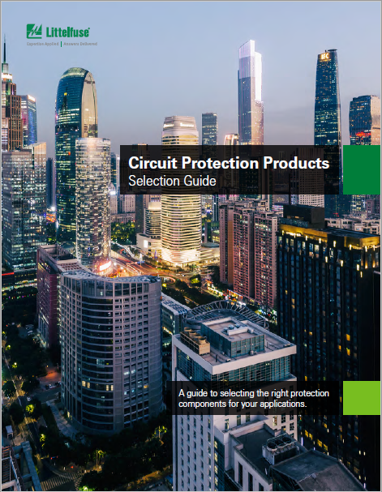



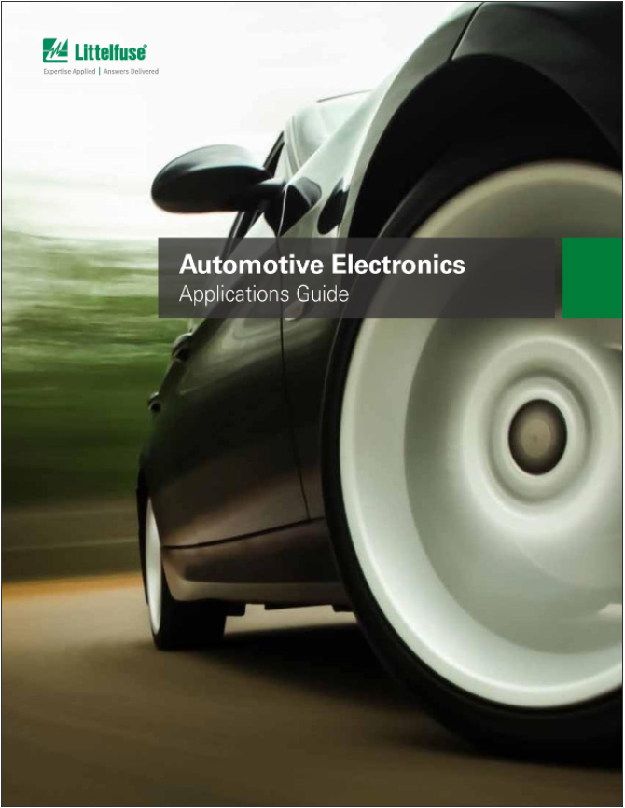
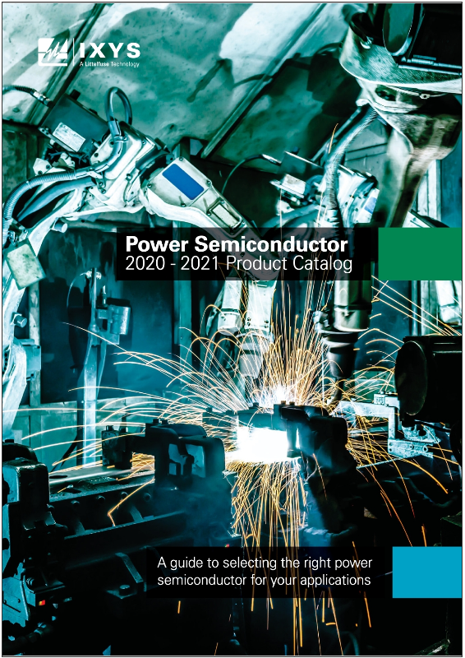
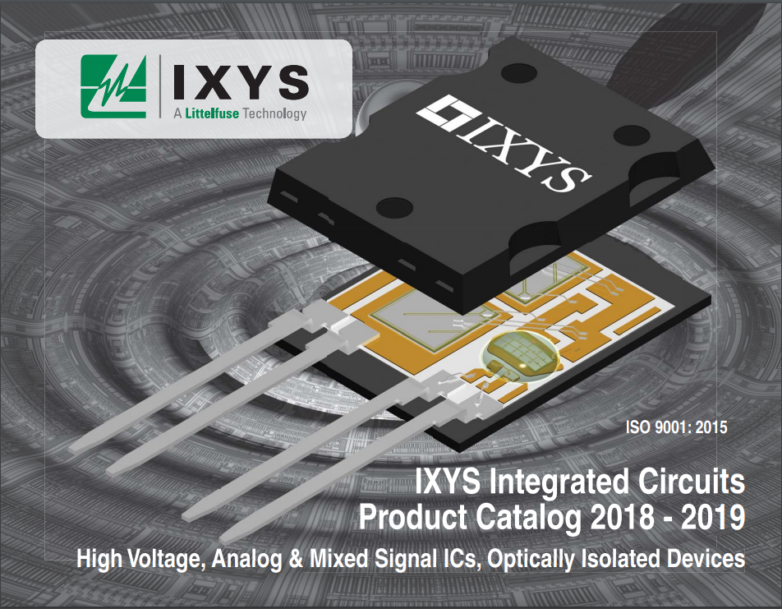
Additional information can be found on Littelfuse.com
Explore the world of Littelfuse with the Electronics eCatalogs (http://electronicscatalogs.littelfuse.com/)
DC Power Distribution
Selection Guide
Circuit Protection Selection Guide
Passenger and Commercial Products
Commercial Vehicle Product
Click on images to open the catalogs
Integrated Circuits
Product Catalog
Power Semiconductor
Selection Guide
Automotive Electronics Application Guide

Slide 18


Local resources supporting our global customers
Mount Prospect
Madison
Chicago
Champaign
Bremen
Lampertheim
Essen
Lauf
Leiden
Amsterdam
Deventer
Burlington
Beijing
Wuxi
Suzhou
Shanghai
Kunshan
Saskatoon
Kaunas
Chippenham
Legnago
Rapid City
Tsukuba
Tokyo
Beverly
Fremont
Milpitas
Long Beach
Dongguan
Hong Kong
Seongham
Seoul
San Sebastian
Round Rock
Charneca de Caparica
Taipei
Chu-pei
Piedras Negras
Matamoros
Muzquiz
New Delhi
Taguig
Lipa City
Singapore
Manaus
São Paulo
Legend
Sales
R&D
Manufacturing

Slide 19


Partner for tomorrow’s electronic systems
A global leader with a broad product portfolio, covering every aspect of protection, sensing, and control
We help customers in the design process to account for requirements set by global regulatory authorities
Broad product portfolio
Compliance & regulatory expertise
Safer
Our engineers partner directly with customers to help speed up product design and meet their unique needs
Application expertise
Testing capabilities
We help customers get products to market faster; we offer certification testing to global regulatory standards
Connected
Greener
Global manufacturing
Global customer service
We offer high-volume manufacturing that is committed to the highest quality standards
Our global customer service team is with you to anticipate your needs and ensure a seamless experience

Slide 20


Littelfuse.com

Slide 21
Internal Combustion Engine Solutions

Slide 22
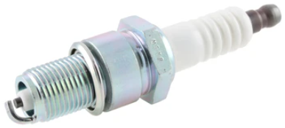
Capacitive Discharge Ignition (CDI)
Current and older ignition system design
Click on the product series in the table below for more info
 | Technology | Series
I | Fuse | 440A, 441A
II | SCR | S6004DS2RP, S6008DS2RP, MCR12DSMT4G
Current regulator
I
I
+
_
Vp
Vs
_
+
II
MCU
Source
III

Slide 23
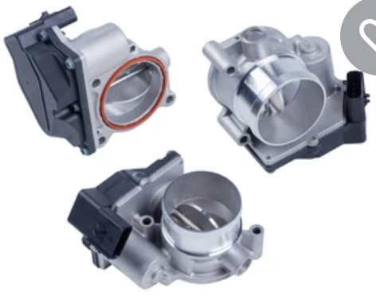
Electronic Fuel Injection (EFI)
Newer, more fuel efficient and less polluting
Click on the product series in the table below for more info
 | Technology | Series
I | Fuse | 440A, 441A
II | PPTC | ASMDC, miniASMDC
III | TVS Diode | TPSMB
IV | Ignition IGBT | LGBxx, LGDxx
Voltage regulator
I
+
_
Vp
Vs
_
+
IV
II
Monitor
Source
+
_
III
ECU
MCU
Sensors

Slide 24
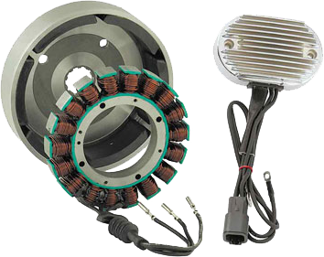
Rectifier and regulator (2 W and 3 W) converts AC to DC for electrical systems
Click on the product series in the table below for more info
 | Technology | Series
I | SCR (x6) | SJxx25xxA, SJxx20xx, SVxx25xx, SVxx20xx
I
Control unit
+
_
R
Y
R/R module
  Rectifier/regulator bridge
  + Filter
  + SCR control circuit
B
I
AC generator
An example of 18-pole,
3-phase output
18-pole generator at 6000 rpm that produces 900 Hz AC output
(f = RPM/120 x poles)

Slide 25
Littelfuse.com
This document is provided by Littelfuse, Inc. (“Littelfuse”) for informational and guideline purposes only. Littelfuse assumes no liability for errors or omissions in this document or for any of the information contained herein. Information is provided on an “as is” and “with all faults” basis for evaluation purposes only. Applications described are for illustrative purposes only and Littelfuse makes no representation that such applications will be suitable for the customer’s specific use without further testing or modification. Littelfuse expressly disclaims all warranties, whether express, implied or statutory, including but not limited to the implied warranties of merchantability and fitness for a particular purpose, and non-infringement. It is the customer’s sole responsibility to determine suitability for a particular system or use based on their own performance criteria, conditions, specific application, compatibility with other components, and environmental conditions. Customers must independently provide appropriate design and operating safeguards to minimize any risks associated with their applications and products. Read complete Disclaimer Notice at: www.littelfuse.com/disclaimer-electronics.

