Slide 1

EV Charging Solutions
EV Infrastructure

Slide 2
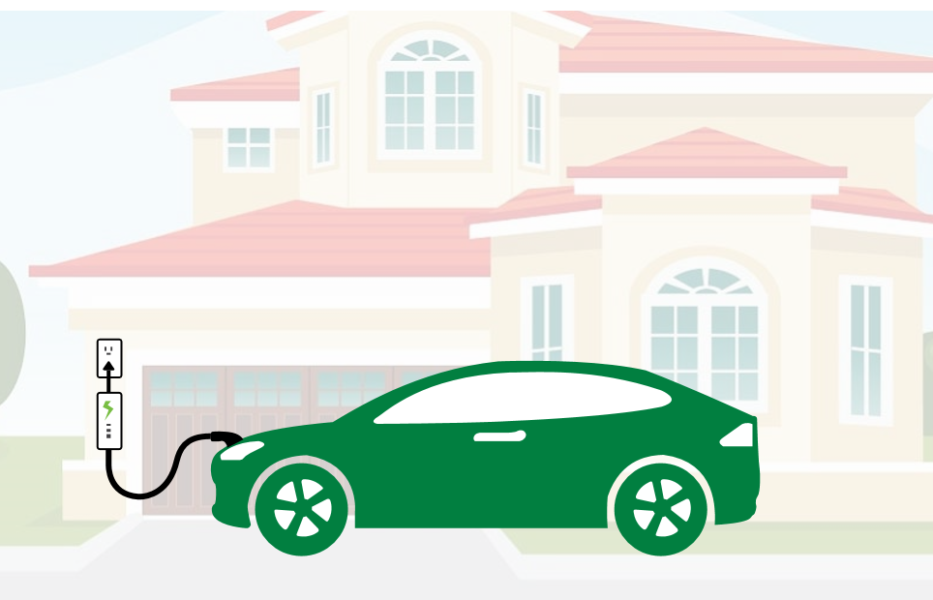
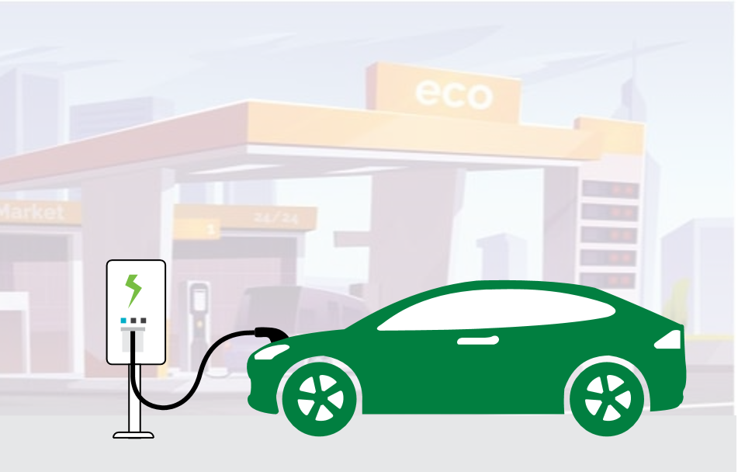
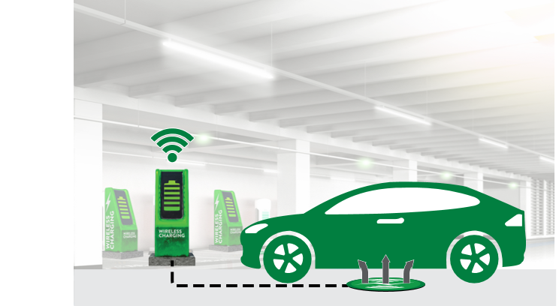

Types of electric vehicle charging stations
AC Level 1*
Basic home installation (Mode 1 or Mode 2)**
Voltage 120 V AC, 1-phase 250 V AC, 1-phase 480 V AC, 3-phase
Current rating 12 A–16 A (32 A for 3-phase)
Charging time 8–12 hours***
AC Level 2*
Home and public installation (Mode 3)**
Voltage 208 V–240 V AC, 1-phase 250 V AC, 1-phase 480 V AC, 3-phase
Current rating 12 A–80 A
Charging time 4–6 hours***
DC Fast Charger*
Public and commercial installation (Mode 4)**
Voltage 380 V–600 V AC, 3-phase
Current rating DC output (up to 400 A)
Charging time 15–30 mins***
Wireless Charger^{ǂ}
Home and public installation
Power levels WPT1 − 3.7 kW WPT2 − 7.7 kW WPT3 − 11 kW
Grid-to-battery efficiency 94% at a 10″ ground clearance
Vehicle ground clearance 100−250 mm (3.9″ to 9.8″)
* As defined by SAE J1772
ǂ As defined by SAE J2954
** As defined by IEC 61851-1
*** Charge time dependent on vehicle’s battery capacity and charge acceptance rate

Slide 3
Global electric vehicle charging equipment market
Market trends and drivers
Increasing production of electrified vehicles: an estimated 5.5 million vehicles in 2021 growing to 33 million vehicles in 2028 ⇨ need for higher efficiency
7.3 million chargers are active across the world (as of 2019), of which, nearly 6.5 million are private chargers, 0.6 million are public slow chargers and 0.26 million are public fast chargers
Currently, more than 70% of the charging is done at home. Convenience, cost efficiency, and a variety of support policies are the main drivers.
Majority of charging to occur at home or workplace during a span of several hours (AC charging) ⇨ bidirectional topologies are needed for smart grid
Limited charging grid capacity in most regions ⇨ emergence of combo ESS+PV with DC charger
Increasing voltage and power output of DC chargers for fast charging ⇨ 500 V to 800 V
Low-power DC charging solution in residential/campus settings will replace the AC charging solution to make charging faster (20 kW DC versus 7 kW AC)
DC chargers create a need for improved safety and additional components, such as advanced liquid-cooled cables, substations, and energy storage systems
Rapid growth of EV at ~25% CAGR
Acronyms:
PV: Photovoltaic
ESS: Energy Storage System
HEV: Battery-Powered Electric Vehicle
PHEV: Plug-In Hybrid Electric Vehicle
Source: IHS Report and Littelfuse estimates

Slide 4
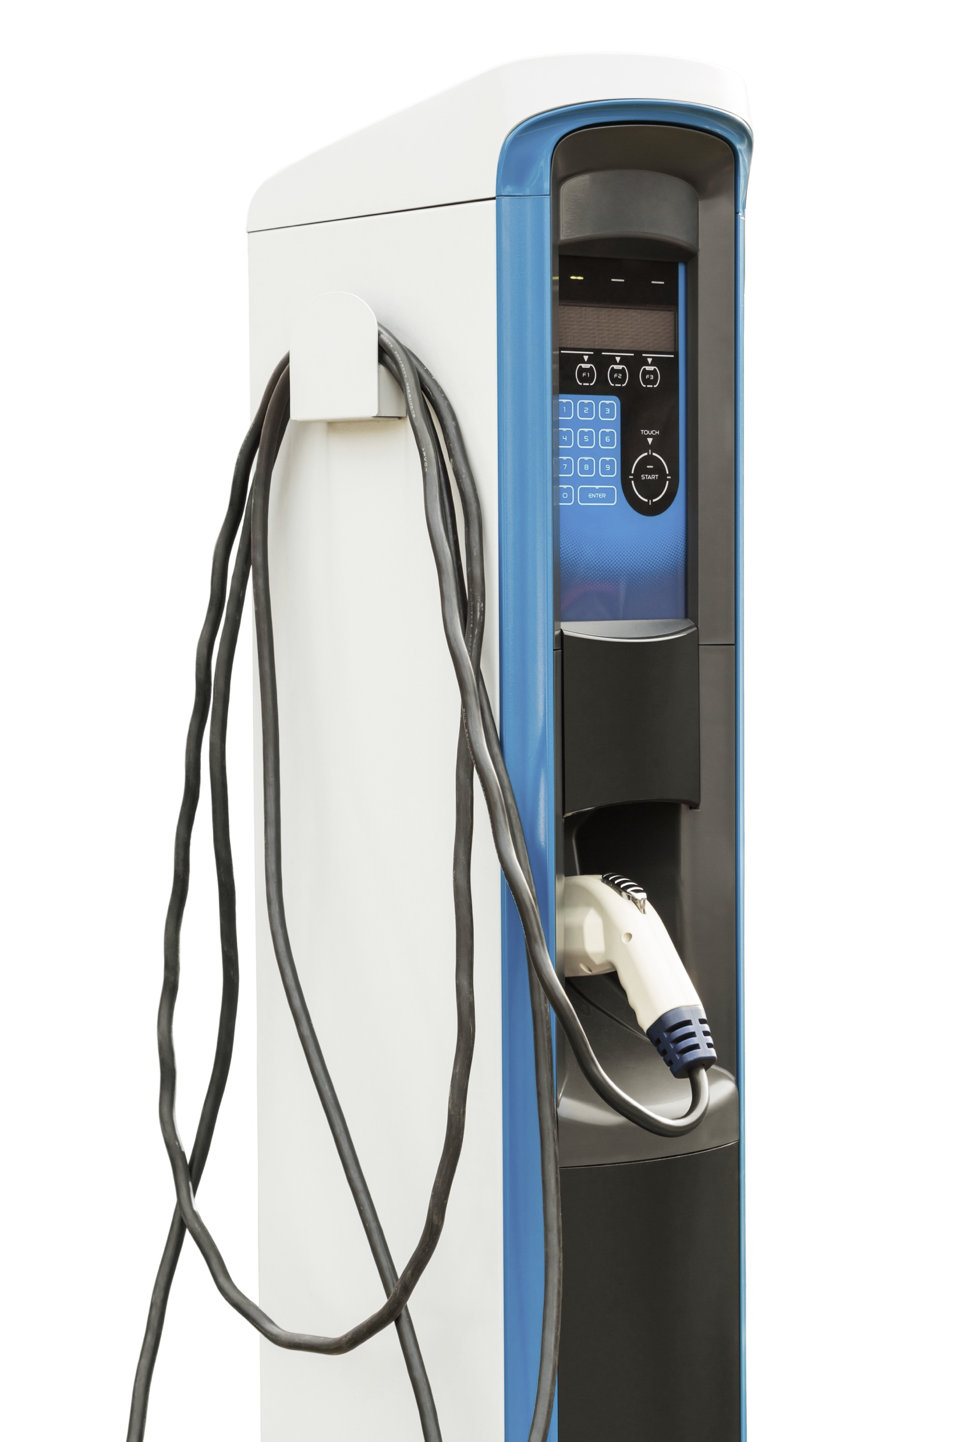
AC charging station
1
Power Board
3
Control Board
● Fuse
● MOV
● AC Contactor
● AC Relay
● Reed Relay
● TVS Diode
● Diode Array
● Linear
Optocoupler
● Solid State Relay
1
3
2
Charging Gun
4
Auxiliary Power Supply
● Reed Sensor
● Temperature Sensor
4
Fuse
PPTC
MOV
SIDACtor®
Schottky Diode
2
MOV: Metal-oxide Varistor
AC: Alternate Current
TVS: Transient Voltage Suppression
PPTC: Polymer Positive Temperature Coefficient

Slide 5

AC charging functional block diagram
Click on the product series in the table below for more info
+t⁰
Power board
 | Technology | Series
I | Fuse | 606, 505, 607
 | MOV | TMOV, Xtreme
II | AC Contactor | HCC 1 & 2 Pole, HCC 3 & 4 Pole
 | AC Relay | SC0x*
III | Temperature Sensor | PPG, USW, Glass Coated Thermistor
IV | Reed Relay | HE3600
V | TVS Diode Polymer ESD | SP1026 XGD10402
VI | Fuse + Varistor or PPTC + Varistor | 215, 443E, TMOV or LVR + MOV
 | Schottky Diode | DST, DSA, DSB
 | SIDACtor + MOV | Pxxx0FNL + UltraMOV
VII | TVS Diode Array | AQ24CAN, SM712
VIII | Reed Sensor | 59060, 59045
IX | Linear Optocoupler | LOC110ST
X | Solid State Relay | CPC1390GRTR, CPC1006NTR, CPC1017
L2
L1
NTC
I
Charging gun
+t⁰
II
+t⁰
N
III
+t⁰
N
PE
PE
Terminal temp sensor
Metering
Driver
Weld
contact
Plug temp sensor
VIII
Plug positioning
IX
GFCI
IV
VII
Comm. Interface
µController
Control pilot proxy
X
VI
Auxiliary power supply
Control
board
Display/LED
V
VI
Auxiliary power supply
LVR (PPTC)
Fuse
+t⁰
TMOV
OR
SMPS
Linear transformer
* Please contact Littelfuse Associates for details

Slide 6
Features and benefits of Littelfuse solutions
Click on the product series in the table below for more info
 | Technology | Function in application | Product series | Benefits | Features
I | Fuse | Primary over-current protection of EV equipment | 606, 505, 607 | Enables robust yet compact design; can operate in extreme temperature environment | Rated voltage @ 500 VAC; 40−63 A rating available; small footprint
 | MOV | Protects from power fluctuations or surges | TMOV, Xtreme | Reduces customer qualification time by complying with third-party safety standards, such as UL/IEC | High energy absorption capability: 40–530 J (2 ms); integrated thermal protection
II | Contactors or Relays | Safety cutoff on the grid (power network) to prevent abnormal current supply | HCC 1 & 2 Pole, HCC 3 & 4 Pole | Predetermined life cycle for application to minimize cost; high electrical and thermal conductivity; good resistance to oxidation for longer life | Long electrical life; high surge capability; certified for use in North America, Europe, and Asia
 |  |  | SC0x* | PCB mount capable; higher flexibility for designers; compact design | Low heat generation and low coil power consumption; performance to meet regulatory UL/IEC compliance
III | Temperature Sensor | DC contacts hotspot detection | PPG, USW, Glass Coated Thermistor | Offers high accuracy; high reliability; excellent stability at high temperatures | Linear relationship between temp and resistance; temp range -50 °C to +500 °C
IV | Reed Relay | Low power switching with up to 2500 V isolation | HE3600 | Low power consumption; galvanic isolation; immune to environmental effects | Miniature single in-line package; external magnetic shield option
V | TVS Diode Array Polymer ESD | Protects ICs from ESD through display | SP1026 XGD10402 | Smaller form-factor and multi-line protection enables ease of design | SP1026 has high ESD robustness for touchpads; XGD10402 has ultra-low capacitance for I/O
VI | Fuse + Varistor | Protects SMPS from damages due to mech overloads, overheating, etc. | 215, 443E, TMOV or LVR + MOV | Reduces customer qualification time by complying with third-party safety standards such as UL/IEC | Compliance with third-party safety standards such as UL/IEC
 | PPTC + Varistor | Protects linear transformers from damages due to mech overloads, overheating, etc. | DST, DSA, DSB | Fast time to trip; offers boards space savings; reduces customer qual time by complying with UL/IEC | Line voltage ratings of 120 and 240 VAC; low resistance; holding current up to 2 A; compact size
 | SIDACtor + MOV | Enhancing surge protection for auxiliary power supply | Pxxx0FNL + UltraMOV | Good clamping and fast response time for high-energy transient protection | 3 kA, 8/20 µs surge capability to help protect AC lines from harmful transient surges
VII | TVS Diode Array | Protects CAN, Ethernet, RS-485 bus from ESD, EFT, and voltage transient | AQ24CAN, SM712 | Ensures reliability of the equipment without performance degradation | Meets ESD protection levels specified under IEC 61000-4-2; ISO10605; low leakage current and clamping voltage
VIII | Reed Sensor | Access panel for position sensing | 59060, 59045 | Robust in end application; mount directly into PCB; no standby power requirement | Well suited for usage in high-moisture and contaminated environments; molded stand-off to allow board washing
IX | Linear Optocoupler | Isolated main voltage sensing in the system | LOC110ST | High gain stability; low input/output capacitance; low power consumption | LED operating range: 2−10 mA; isolation: 3750 V_{RMS}
X | Solid State Relay | Controls board isolation | CPC1390GRTR, CPC1006NTR, CPC1017 | High reliability; low drive current; no EMI/RFI generation | Isolation voltage up to 5000 V_{RMS}; low off-state leakage; SMD package

Slide 7
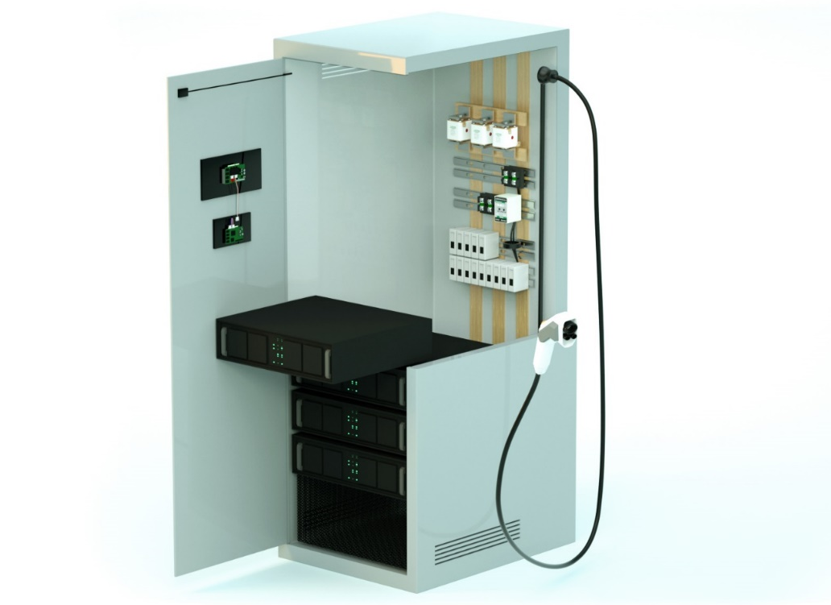
DC charging station
1
Service Access Panel
6
Power Distribution Unit
Reed Sensor
1
● Fuse
6
2
User Interface
7
Input Protection
● TVS Diode Array
● Polymer ESD Suppressor
2
Fuse
Surge Protection Device
TVS Diode
Current Transformer
AC Earth Fault Relay
7
3
Communication
8
● TVS Diode Array
3
10
4
Rectification & PFC
8
DC Output Protection
● SiC/Si MOSFET
● Rectifier Diode/Module
● Gate Driver
● Temperature Sensor
4
DC Fuse
HVDC Contactor
Earth Fault Relay
5
9
5
DC-DC Conversion
9
Auxiliary Power Supply
● SiC/Si MOSFET
● Rectifier Diode/Module
● Gate Driver
● Temperature Sensor
10
Charging Plug
● Fuse
● MOV, GDT, SIDACtor® + MOV
● Si MOSFET
● Rectifier Diode
● Temperature Sensor
● Reed Sensor
TVS: Transient Voltage Suppression
SiC: Silicon Carbide
Si: Silicon
DC: Direct Current
AC: Alternate Current
HVDC: Heavy Voltage Direct Current
MOV: Metal-oxide Varistor
GDT: Gas Discharge Tubes

Slide 8
DC charger cabinet-level protection
Click on the product series in the table below for more info
AC
DC
 | Technology | Series
I | Fuse x 3 | PSR, L50QS, L75QS
II | Ground Fault Relay | SE-704, SE-CS30
III | AC Contactor | HCD
IV | AC Relay | SC0x*
V | Fuse + Fuseholder | LVSP + LPSM
VI | Surge Protection Device | SPD Type 2
VII | DC Contactor Relay x 2 | DCNxx
VIII | Fuse x 3 | SFPJ, PSR, EV1K
IX | Solid State Relay | CPC1981Y, PLA192E, PLA193E
Power converter
CCS
Tº
Main isolator
VII
VIII
AC main
I
II
III
Power converter
2
1
RCD high immunity
CHAdeMO
Tº
4
3
6
5
Power converter
8
7
Power converter
IX
Isolation monitoring
Isolation monitoring
Control
Control pilot proxy
24 V Aux PSU
* Please contact Littelfuse Associates for details
IV
Heater
Temperature sensing
V
Acronyms:
RCD: Residual Current Device
CCS: Combined Charging System
PLC: Power Line Communication
CHAdeMO: DC charging protocol currently enabling EV charging with power from 6 kW to 400 kW with 900 kW in preparation
Communication interface
(PLC, 5G, Zigbee,
RS-485, Ethernet)
VI

Slide 9
Features and benefits of Littelfuse solutions
Click on the product series in the table below for more info
 | Technology | Function in application | Product series | Benefits | Features
I | Fuse x 3 | Protects semiconductor devices | PSR, L50QS, L75QS | Lower I²t performance allows for quick response to protect devices from higher heat energy | 550–1300 V_{AC}, 500–1000 V_{DC}, 40–2000 A
II | Current Transformer | Offers ground-fault detection and protection | SE-CS30 | Specifically designed for low-level detection; flux conditioner is included to prevent saturation | Turns ratio 600:1 and current rating 30:0.05 A
 | AC Earth-Fault Relay |  | SE-704 | No calibration; low-level protection and system coordination; low maintenance | Microprocessor-based; adjustable pickup (10 mA−5 A); adjustable time delay (30 ms−2 s)
III | AC Contactor | Safety cutoff on the grid (power network) to prevent abnormal current supply | HCD | Predetermined life cycle for application to minimize cost; high electrical and thermal conductivity; good resistance to oxidation for longer life | Long electrical life; high surge capability; certified for use in North America, Europe, and Asia
IV | AC Relay | Safety cutoff on the grid (power network) to prevent abnormal current supply. | SC0x* | PCB mount capable; higher flexibility for designers; compact design | Low heat generation and low coil power consumption; performance to meet regulatory UL/IEC compliance
V | Fuse + Fuseholder | This is an optional surge suppression fuse (+ fuse holder) intended to protect surge protection devices | LVSP + LPSM | Very current limiting under AC short-circuit conditions; available in multiple mounting configurations (cartridge, bolt-in, PC board mount) | Survive the 8x20 µs lightning surges described in various standards (UL 1449, IEC 61000-4-5, and IEEE C62.41) without opening
VI | Surge Protection Device | Protects from power fluctuations or surges | SPD Type 2 | Withstands high-energy transients to prevent disruption, downtime, and degradation | 20 kA nominal interrupting rating and 50 kA maximum interrupting rating
VII | DC Contactor Relay x 2 | The main contactors connect and disconnect the DC charging unit | DCNxx | Allows a low-voltage signal to switch the contacts for a high-voltage signal | Wide range of capabilities–can switch from tens of amps to thousands of amps and tens of volts to thousands of volts
VIII | Fuse x 3 | Protects semiconductor devices | SFPJ, PSR, EV1K | Lower I²t performance allows for quick response to protect devices from higher heat energy | 500–1000 V_{DC}, 40–2000 A
IX | Solid State Relay | DC leakage current detection | CPC1981Y, PLA192E, PLA193E | High reliability; low drive power requirements; no EMI/RFI generation | 2500–5000 V_{RMS} input/output isolation; handle load currents up to 0.25 A; power SIP & SMD package

Slide 10
DC charger subunit power converter
(15~20 kW−Vienna Rectifier)
Click on the product series in the table below for more info
 | Technology | Series
I | Fuse | 606, 505, 607
II | MOV (Secondary protection) | TMOV, UltraMOV
 | GDT (Secondary protection) | CG2, CG3
 | SIDACtor® + MOV (Secondary protection) | Pxxx0FNL + UltraMOV
III | Diode | DSEPxx, DMA, DST, DSA, DSB
IV | MOSFET | X-Class, X2-Class, X3-Class
 | Gate Driver | IXD_6xx
IV | MOSFET | X-Class, X2-Class, X3-Class
 | Gate Driver | IXD_6xx, IX4351NE
V | Diode | DSEPxx
VI | Diode | DLAxx, DSIxx, DMA, DHG, DSEI
Input AC
380 V
III
V
VI
IV
I
III
V
III
II
OR
Other recommended products:
ESD protection: AQ24CAN, SM712, SP1026, and XGD10402
Temperature sensing: USUR1000 and KC
* Please contact Littelfuse Associates for details

Slide 11
Features and benefits of Littelfuse solutions
Click on the product series in the table below for more info
 | Technology | Function in application | Product series | Benefits | Features
I | Fuse | Overcurrent protection of auxiliary power supply | 606, 505, 607 | Enables robust yet compact design; can operate in extreme temperature environment | Rated voltage @ 500 VAC; 40−63 A rating available; small footprint
II | MOV | GDT in series with TMOV protects the auxiliary power supply unit from voltage transients induced by lightning | TMOV, UltraMOV | Reduces customer qualification time by complying with third-party safety standards such as UL/IEC | High energy absorption capability: 40–530 J (2 ms); integrated thermal protection
 | GDT |  | CG2, CG3 | Small form factor allows for compact system design | High energy absorption capability; small form factor; low leakage current
 | SIDACtor + MOV | Enhancing surge protection for auxiliary power supply | Pxxx0FNL + UltraMOV | Good clamping and fast response time for high-energy transient protection | 3 kA, 8/20 µs surge capability to help protect AC lines from harmful transient surges.
III | Diode | Vienna rectifier | DSEPxx, DMA, DST, DSA, DSB | Improves power supply unit efficiency | Low forward voltage drop; high-frequency operation; high junction temperature
IV | MOSFET | Boosts converter for high-frequency switching in the PFC circuit | X-Class, X2-Class, X3-Class | Optimized for high-frequency applications | Ultra-low output capacitance and on-resistance
 | Gate Driver | Controls the switching MOSFETs | IXD_6xx | Quick turn-on and turn-off of MOSFETs/IGBTs; eliminates the need for separate supply | 9 A peak current; low propagation delay time; low output impedance
IV | SiC or Si MOSFET | Primary side of the DC-DC converter | X-Class, X2-Class, X3-Class | Optimized for high-frequency applications | Ultra-low on-resistance R_{DS(ON)} and gate charge Qg; dv/dt ruggedness
 | Gate Driver | Controls the switching MOSFETs | IXD_6xx, IX4351NE | Quick turn-on and turn-off of MOSFETs/IGBTs; eliminates the need for separate supply | 9 A peak current; low propagation delay time; low output impedance
V | Diode | Secondary side output rectification of DC-DC converter | DSEPxx | Reduces switching losses; increases efficiency | High surge capability; neg­ligible I_{RR}; Tj 175 °C
VI | Diode | Redundant diode for secondary protection | DLAxx, DSIxx, DMA, DHG, DSEI | Compact design; low turn-on loss; lower power dissipation | High voltage options; very low forward voltage drop; small form factor

Slide 12
DC charger subunit power converter
(Bidirectional SiC-based power converter)
Click on the product series in the table below for more info
ICL
+t⁰
Active front end
DC bus
Active front end
III
V
 | Technology | Series
I | Fuse | 606, 505, 607
II | MOV | MOV, Xtreme
III | Discrete Thyristor | SCR
IV | SiC MOSFET or Phase Leg IGBT | LSIC
 | Phase Leg IGBT | SMPD
V | Fuse | SPF, 526*, 607, 828
I
IV
EMI
filter
II
DC/DC #1
DC/DC #N
II
DC−DC converter
DC-DC
 | Technology | Series
I | Discrete MOSFET | IXTA 1200V TO263
II | Fuse | SPF
III | SiC MOSFET or Phase Leg IGBT | LSIC
 | Phase Leg IGBT | SMPD
IV | Fuse | SPF, 526*, 607, 828
I
IV
+t⁰
III
III
Acronyms:
ICL: Inrush Current Limiters
* Please contact Littelfuse Associates for details

Slide 13
Features and benefits of Littelfuse solutions
Click on the product series in the table below for more info
Active front end
 | Technology | Function in application | Product series | Benefits | Features
I | Fuse | Overcurrent protection of auxiliary power supply | 606, 505, 607 | Enables robust yet compact design; can operate in extreme temperature environment | Rated voltage @ 500 VAC; 40−63 A rating available; small footprint
II | MOV | Protects from power fluctuations or surges | MOV, Xtreme | Reduces customer qualification time by complying with third-party safety standards such as UL/IEC | High energy absorption capability: UL/IEC approved voltage rating: 130 VAC–680 VAC
III | Discrete Thyristor | Inrush current limiter | SCR | Protects the body diode of the rectification circuitry | Broadest portfolio of low- and medium-voltage SCR devices; multiple package options
IV | SiC MOSFET or Phase Leg IGBT | Active rectification | LSIC | Optimized for high-frequency applications | Ultra-low output capacitance and on-resistance
 | Discrete IGBT |  | SMPD | Board space savings; offers more design flexibility | Ultra-low and compact package profile; low package inductance; excellent thermal capability; high power cycling capability
V | Fuse | Protects semiconductor devices | SPF, 526*, 607, 828 | Lower I²t performance allows a quick response to protect devices from higher heat energy | 500–1000 V_{DC}, 1 A–63 A; compact size (10x32 mm or 10x38 mm); interrupt rating: 10–50 kA
DC−DC converter
 | Technology | Function in application | Product series | Benefits | Features
I | Discrete MOSFET | Discharges circuit (prevents electrical hazards during maintenance) | IXTA 1200V TO263 | Easy to mount; space savings; high power density | HV package; fast intrinsic diode; avalanche rated; high blocking voltage
II | Fuse | Protects output semiconductor devices | SPF | Lower I²t performance allows a quick response to protect devices from higher heat energy | 1000 V_{DC}, 1–30 A ratings available; UL & IEC approved
III | SiC MOSFET or Phase Leg IGBT | Active rectification | LSIC | Optimized for high-frequency applications | Ultra-low output capacitance and on-resistance
 | Discrete IGBT |  | SMPD | Board space savings; offers more design flexibility | Ultra-low and compact package profile; low package inductance; excellent thermal capability; high power cycling capability
IV | Fuse | Protects input semiconductor devices | SPF, 526*, 607, 828 | Lower I²t performance allows a quick response to protect devices from higher heat energy | 500–1000 V_{DC}, 1 A–63 A; compact size (10x32 mm or 10x38 mm); interrupt rating: 10–50 kA

Slide 14
Select standards for EV charging equipment
Standard | Title | General Scope | Region
IEC 61851 Series | Electric Vehicle Conductive Charging System | Various parts of this standard cover general requirements, along with AC chargers and DC chargers specifically | Global
IEC 62196 Series | Plugs, Socket Outlets, Vehicle Connectors, and Vehicle Inlets─ Conductive Charging of Electric Vehicles | Standards for charging plugs, sockets, and connectors | Global
IEC 61980 Series | Electric Vehicle Wireless Power Transfer (WPT) Systems | Various parts of this standard cover general requirements for wireless charging systems, along with specific technology-based requirements | Global
GB/T 18487 Series | Electric Vehicle Conductive Charging System | Various parts of this standard cover general requirements, along with AC chargers and DC chargers specifically | China
GB/T 20234 Series | Connection Set for Conductive Charging of Electric Vehicles | Standards for charging plugs in China | China
SAE J1772* | Electric Vehicle and Plug-in Hybrid Electric Vehicle Conductive Charge Coupler | Physical, electrical, functional, and performance standard for charging plugs in North America | North America
SAE J2954* | Wireless Power Transfer for Light-Duty Plug-In/Electric Vehicles and Alignment Methodology | Interoperability, electromagnetic compatibility, EMF, minimum performance, safety, and testing for wireless chargers in North America | North America
UL 2594 | Standard for Electric Vehicle Supply Equipment | Safety standard for supply equipment (charging stations, cord sets, power outlets, etc.) in North America. Tri-national standard for the U.S., Canada, and Mexico (known as CAN/CSA C22.2 No. 280 in Canada and NMX-J-677-ANCE in Mexico) | North America
UL 2202 | Standard for Electric Vehicle (EV) Charging System Equipment | Safety standard for electric vehicle charging equipment | U.S.
* J1772TM and J2954TM are registered trademarks of SAE International

Slide 15
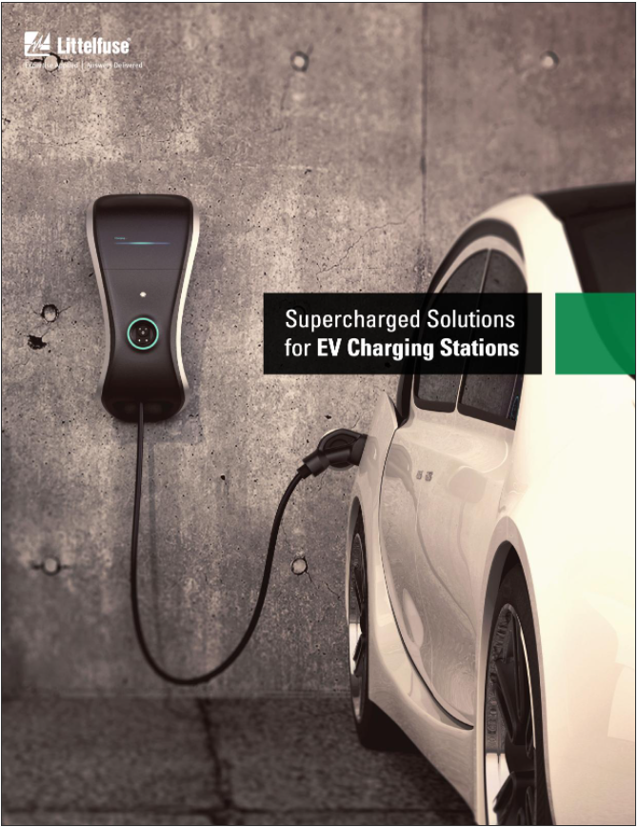
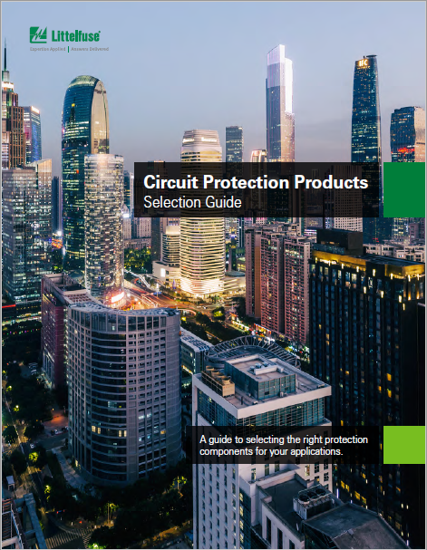
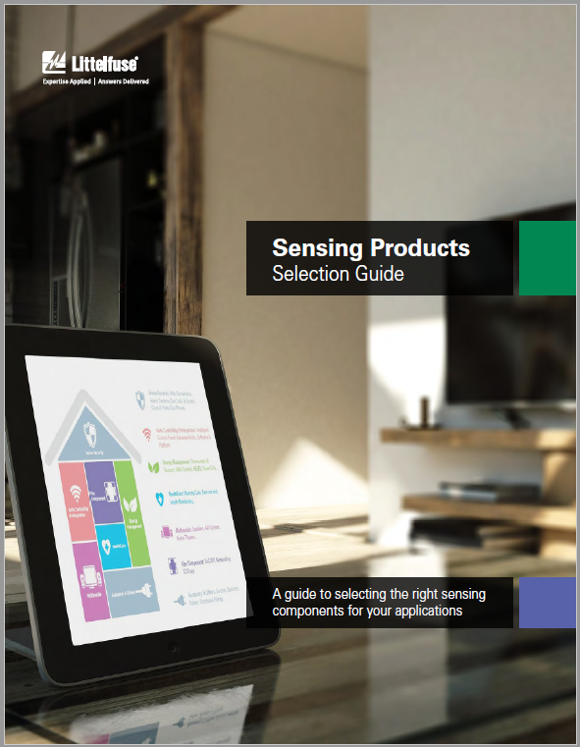
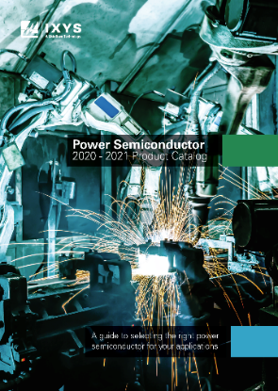


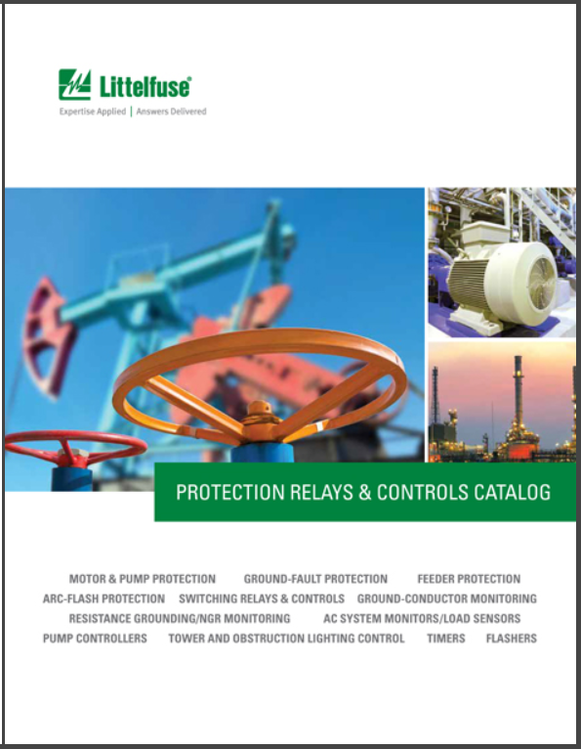
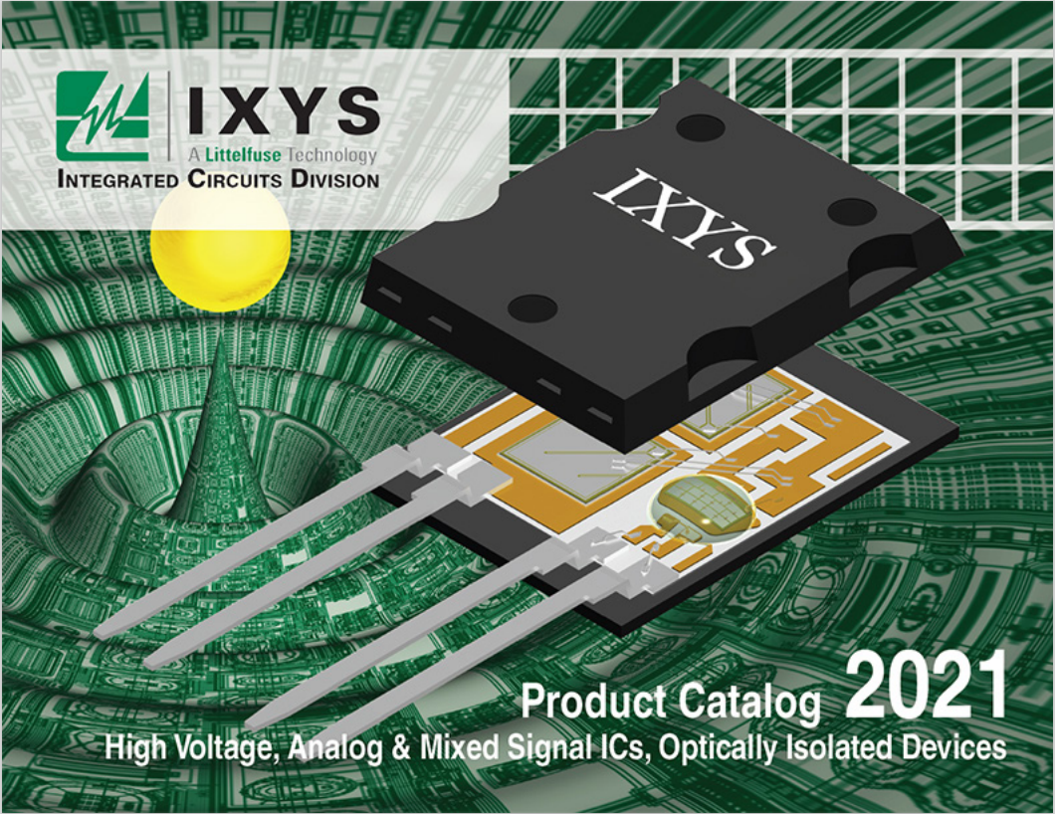
Additional information can be found on Littelfuse.com
Explore the world of Littelfuse with the electronics eCatalogs (http://electronicscatalogs.littelfuse.com/)
EV Charging Brochure
Circuit Protection Catalog
Sensor Selection Guide
Power Semiconductor Catalog
Click on images to open the catalogs
Surge Protection Devices Catalog
Industrial Fuses Catalog
Power Relay & Control Catalog
Integrated Circuits Catalog

Slide 16


Local resources supporting our global customers
Mount Prospect
Madison
Chicago
Troy
Champaign
Rock Falls
Bremen
Lampertheim
Essen
Lauf
Amsterdam
Deventer
Beijing
Wuxi
Suzhou
Shanghai
Kunshan
Burlington
Saskatoon
Kaunas
Chippenham
Legnago
Rapid City
Tsukuba
Tokyo
Beverly
Dongguan
Shenzhen
Hong Kong
Fremont
Milpitas
Long Beach
San Sebastian
SeongnamSeoul
Round Rock
Charneca de Caparica
Taipei
Chu-pei
Piedras Negras
Matamoros
Muzquiz
New Delhi
Taguig
Lipa City
Singapore
Manaus
São Paulo
Legend
Sales
R&D
Manufacturing

Slide 17
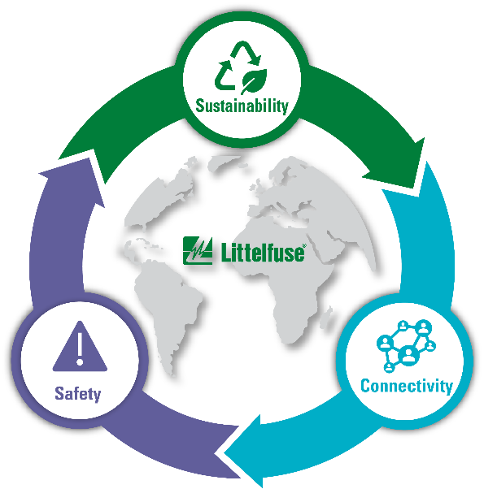
Partner for tomorrow’s electronic systems
BROAD
PRODUCT PORTFOLIO
COMPLIANCE AND
REGULATORY EXPERTISE
An industrial technology manufacturing company empowering a sustainable, connected, and safer world
To help customers in the design process to account for requirements set by global regulatory authorities
APPLICATION
EXPERTISE
TESTING
CAPABILITIES
Our engineers partner directly with customers to help speed up product design and meet their unique needs
To help customers get products to market faster, we offer certification testing for global regulatory standards
GLOBAL
CUSTOMER SERVICE
GLOBAL
MANUFACTURING
Our global customer service team is with you to anticipate your needs and ensure a seamless experience
High-volume manufacturing that is committed to the highest quality standards

Slide 18


Littelfuse.com
This document is provided by Littelfuse, Inc. (“Littelfuse”) for informational and guideline purposes only. Littelfuse assumes no liability for errors or omissions in this document or for any of the information contained herein. Information is provided on an “as is” and “with all faults” basis for evaluation purposes only. The applications described are for illustrative purposes only, and Littelfuse makes no representation that such applications will be suitable for the customer’s specific use without further testing or modification. Littelfuse expressly disclaims all warranties, whether express, implied, or statutory, including but not limited to the implied warranties of merchantability and fitness for a particular purpose, and non-infringement. It is the customer’s sole responsibility to determine the suitability to a particular a particular system or use based on their own performance criteria, conditions, specific application, compatibility with other components, and environmental conditions. Customers must independently provide appropriate design and operating safeguards to minimize any risks associated with their applications and products. Read the complete Disclaimer Notice at: www.littelfuse.com/disclaimer-electronics.

