Slide 1
Water/Wastewater Product Capabilities

Slide 2
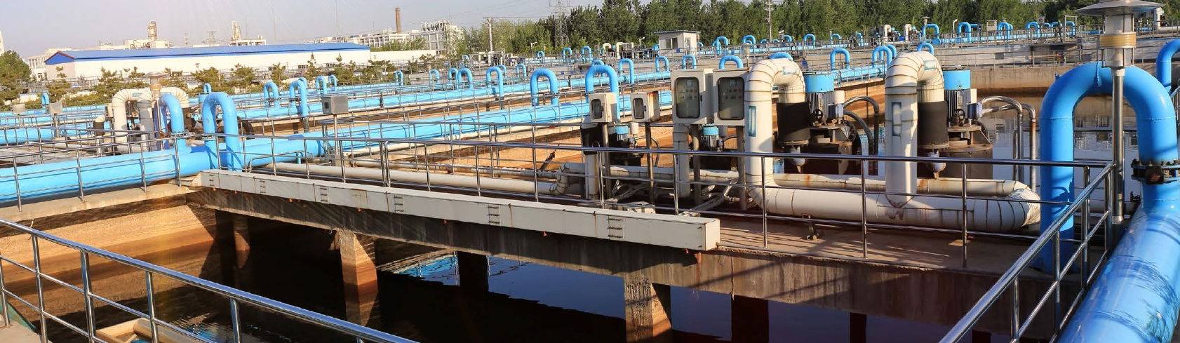
Robust Protection and Controls for
Water/Wastewater Critical Infrastructure
Protect critical operations
with a wide range of
Littelfuse relays and controls
built tough to withstand
Water & Wastewater
harsh conditions.
Notes:
Harsh conditions: : vibration, humidity, hydrogen-sulfide, and extreme temperatures
Robust protection includes: Conformal coating, product testing, experience in mining, oil & gas, warranty

Slide 3
Protection for Water/Wastewater Applications
Recommended Protection | Pumping Stations | Water Treatment | Lift Stations | Water Tower | Water Wells | Odor Control
UL Class & Class CC Fuses
Fuse Blocks & Holders
Overload Relays
Voltage/Phase Monitors
Alternating Relays
Intrinsically Sales Relays
Seal Leak Detectors
Pump Controllers
Time-Delay Relays
Flashers
Arc-Flash Relays
Industrial GFCIs
Ground-Fault Relays
Contactors
Transformers

Slide 4
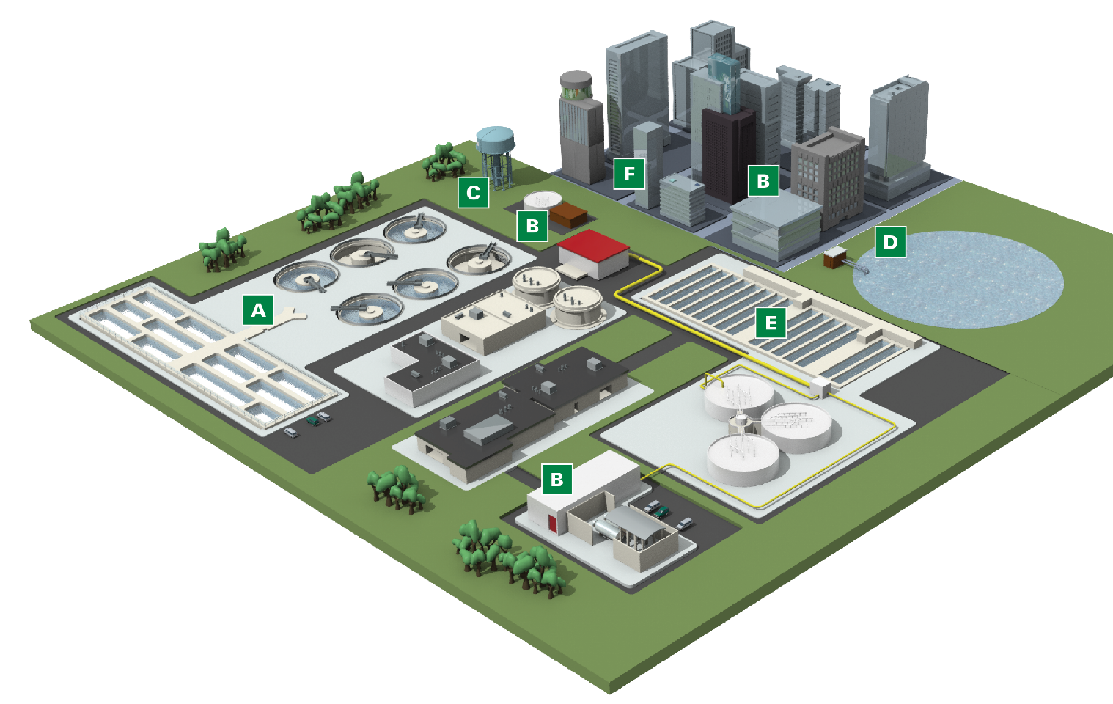
Solutions for Water/Wastewater Applications
A
Water Treatment
Motor & Pump Protection
Flashers | UL Industrial Power Fuses, Blocks, and Holders | Transformers
F
Lift Stations
Motor & Pump Protection | Alternating Relays
Intrinsically Safe Relays | Time Delay Relays Seal Leak Detectors | Flashers | Transformers
Fuses, Blocks, and Holders
B
Water Wells & Pumping Stations
Motor & Pump Protection
Safety Relays | Shock Protection Flashers | UL Industrial Power Fuses, Blocks, and Holders | Transformers
C
Water Tower
Motor Protection | Safety Relays
Fuses, Blocks, and Holders
D
Freshwater Pumping Stations
Motor & Pump Protection
Alternating Relays | Flashers
Time Delay Relays | Seal Leak Detectors
Fuses, Blocks, and Holders
Transformers | Capacitors
E
Odor Control Systems
Motor & Pump Protection
Safety Relays | Flashers
Fuses, Blocks, and Holders
4

Slide 5

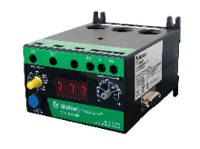
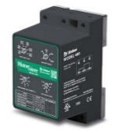
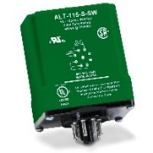
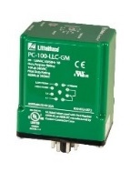
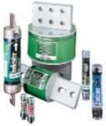





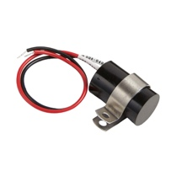
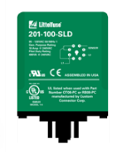
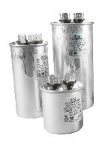
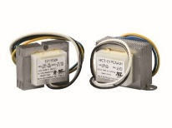
Protection for Storm-Water Pumping Stations
Pump
Bluetooth Enabled Overload Relay
Enhanced Overload Relay
Voltage Monitors
Alternating Relay
Pump Controllers / Liquid Level
Time Delay Relays
UL Class Fuses
LF Series Blocks & Covers
Notification
Control
Flashers
Seal Leak Detectors
Capacitors
Transformers

Slide 6
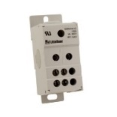

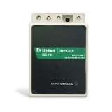

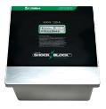
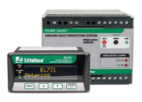

Protection for Water and Wastewater Treatment
Motor and Pump
Bluetooth Enabled Overload Relay
Enhanced Overload Relay
Voltage Monitors
Alternating Relay
Pump Controllers / Liquid Level
Time Delay Relays
UL Class Fuses
LF Series Blocks & Covers
Power Distribution Blocks
Safety
Control
Intrinsically Safe Relays
Arc-Flash Protection
Industrial GFCI
Ground-Fault Relays
Transformers

Slide 7
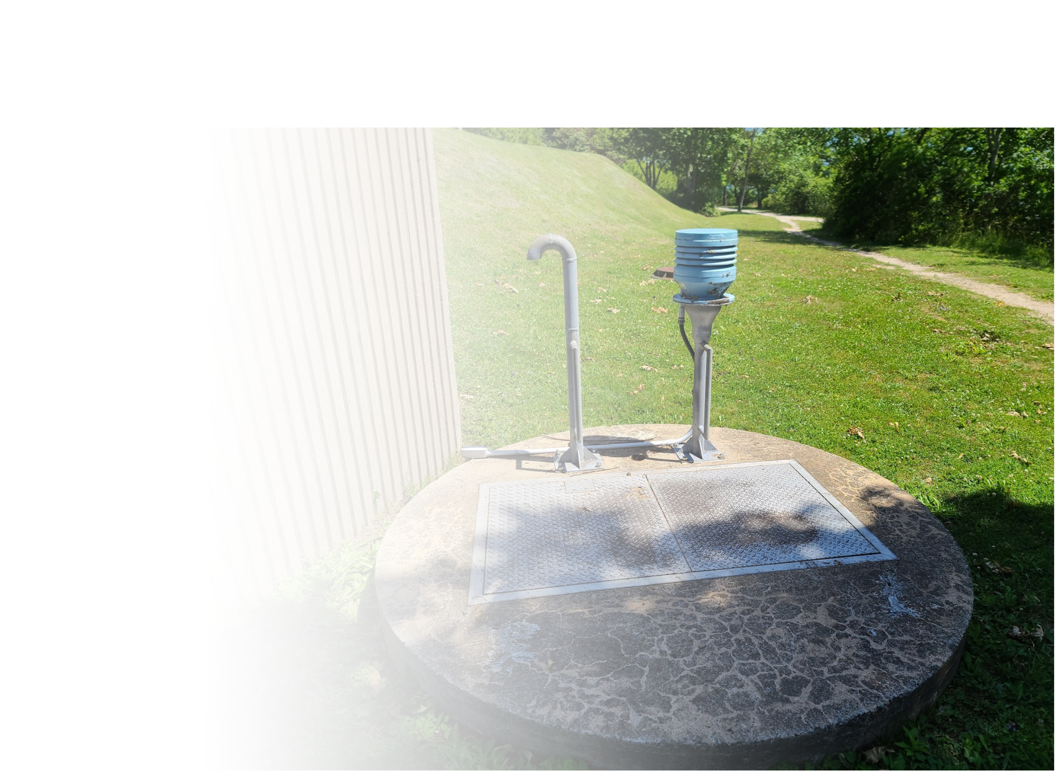
Protection for Lift Stations
Pump
Bluetooth Enabled Overload Relay
Enhanced Overload Relay
Voltage Monitors
Alternating Relay
Pump Controllers / Liquid Level
Time Delay Relays
UL Class Fuses
LF Series Blocks & Covers
Power Distribution Blocks
Safety
Notification
Control
Intrinsically Safe Relays
Arc-Flash Protection
Ground-Fault Relays
Flashers
Seal Leak Detectors
Transformers

Slide 8
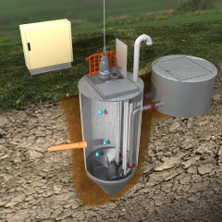
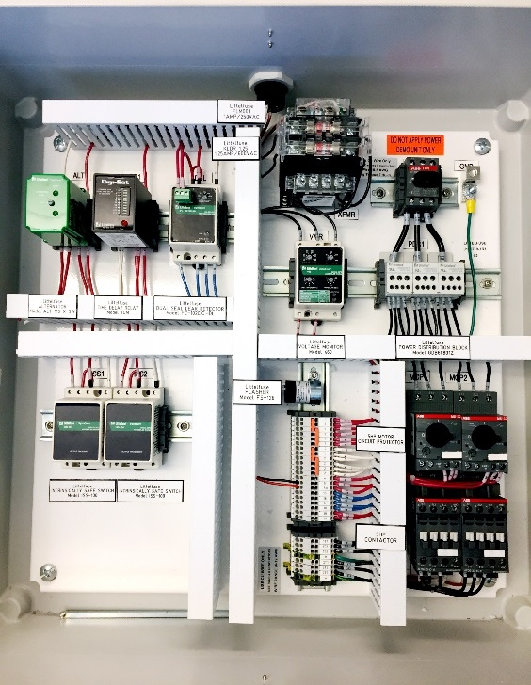
Protection for Lift Stations
Lift Station Control Panel
protected by Littelfuse Relays & Fuses
Control
Panel
Midget Fuses
Time Delay Relay
Class CC Fuses
Alternating Relay
Power
Distribution Block
Seal Leak
Detector
Voltage Monitor
Intrinsically Safe
Relay
Flasher
Legend
Illustration credit: GlobalSpec (Engineering360)
Pump Protection
Safety
Notification

Slide 9
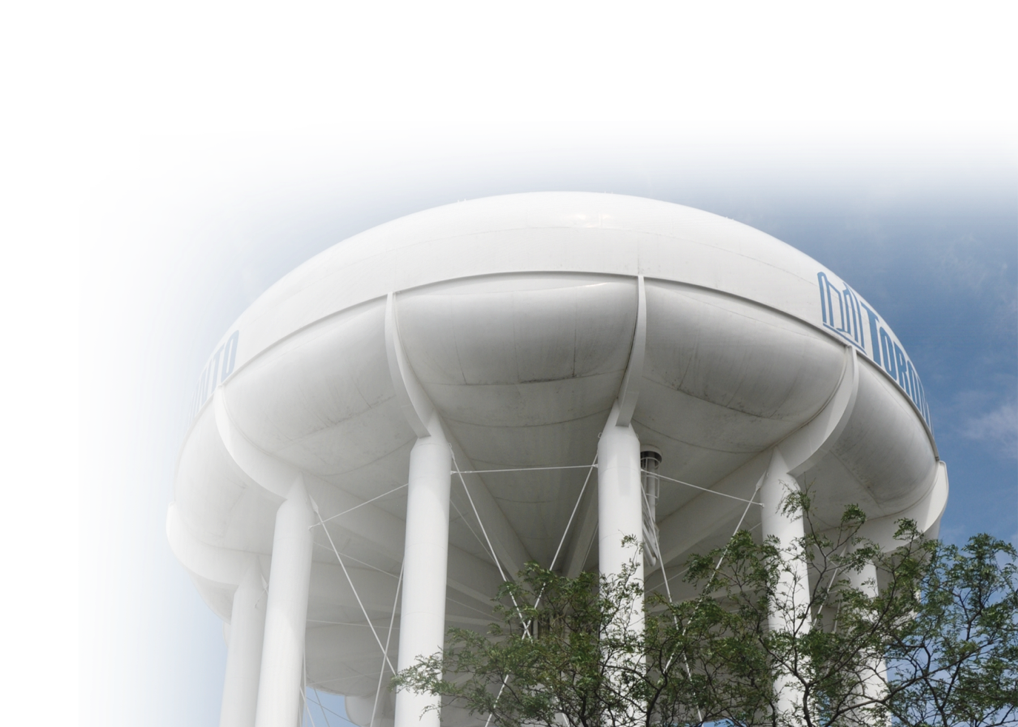
Protection for Water Tower Pumps
Motor and Pump
Bluetooth Enabled Overload Relay
Enhanced Overload Relay
Voltage Monitors
Alternating Relay
Pump Controllers / Liquid Level
UL Class Fuses
LF Series Blocks & Covers
Power Distribution Blocks
Safety
Arc-Flash Protection
Ground-Fault Relays

Slide 10
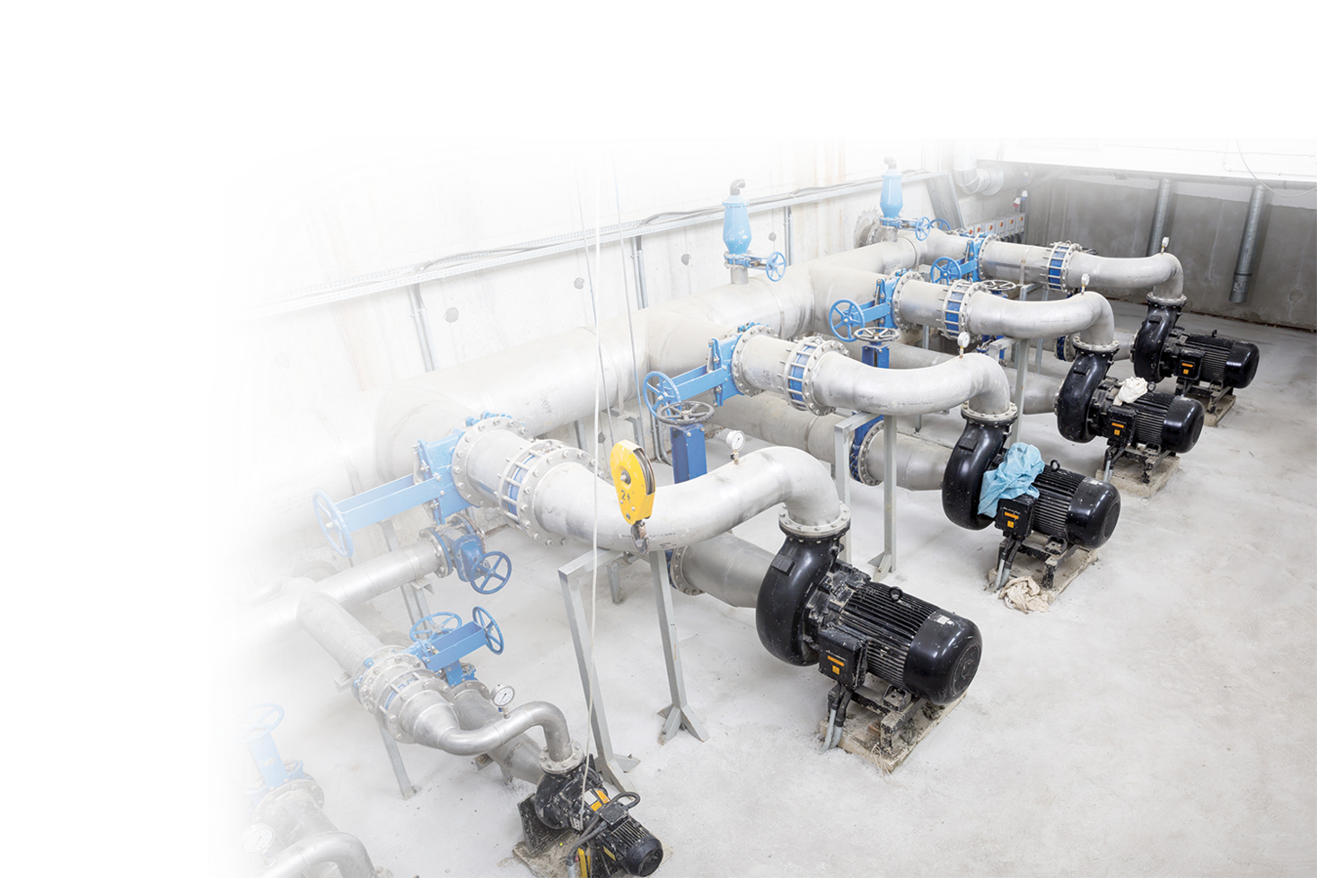
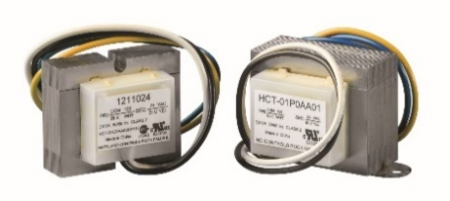
Protection for Water Wells/Pumping Stations
Motor and Pump
Bluetooth Enabled Overload Relay
Enhanced Overload Relay
Voltage Monitors
Alternating Relay
Pump Controllers / Liquid Level
Time Delay Relays
UL Class Fuses
LF Series Blocks & Covers
Safety
Notification
Control
Industrial GFCI
Ground-Fault Relays
Flashers
Transformers

Slide 11
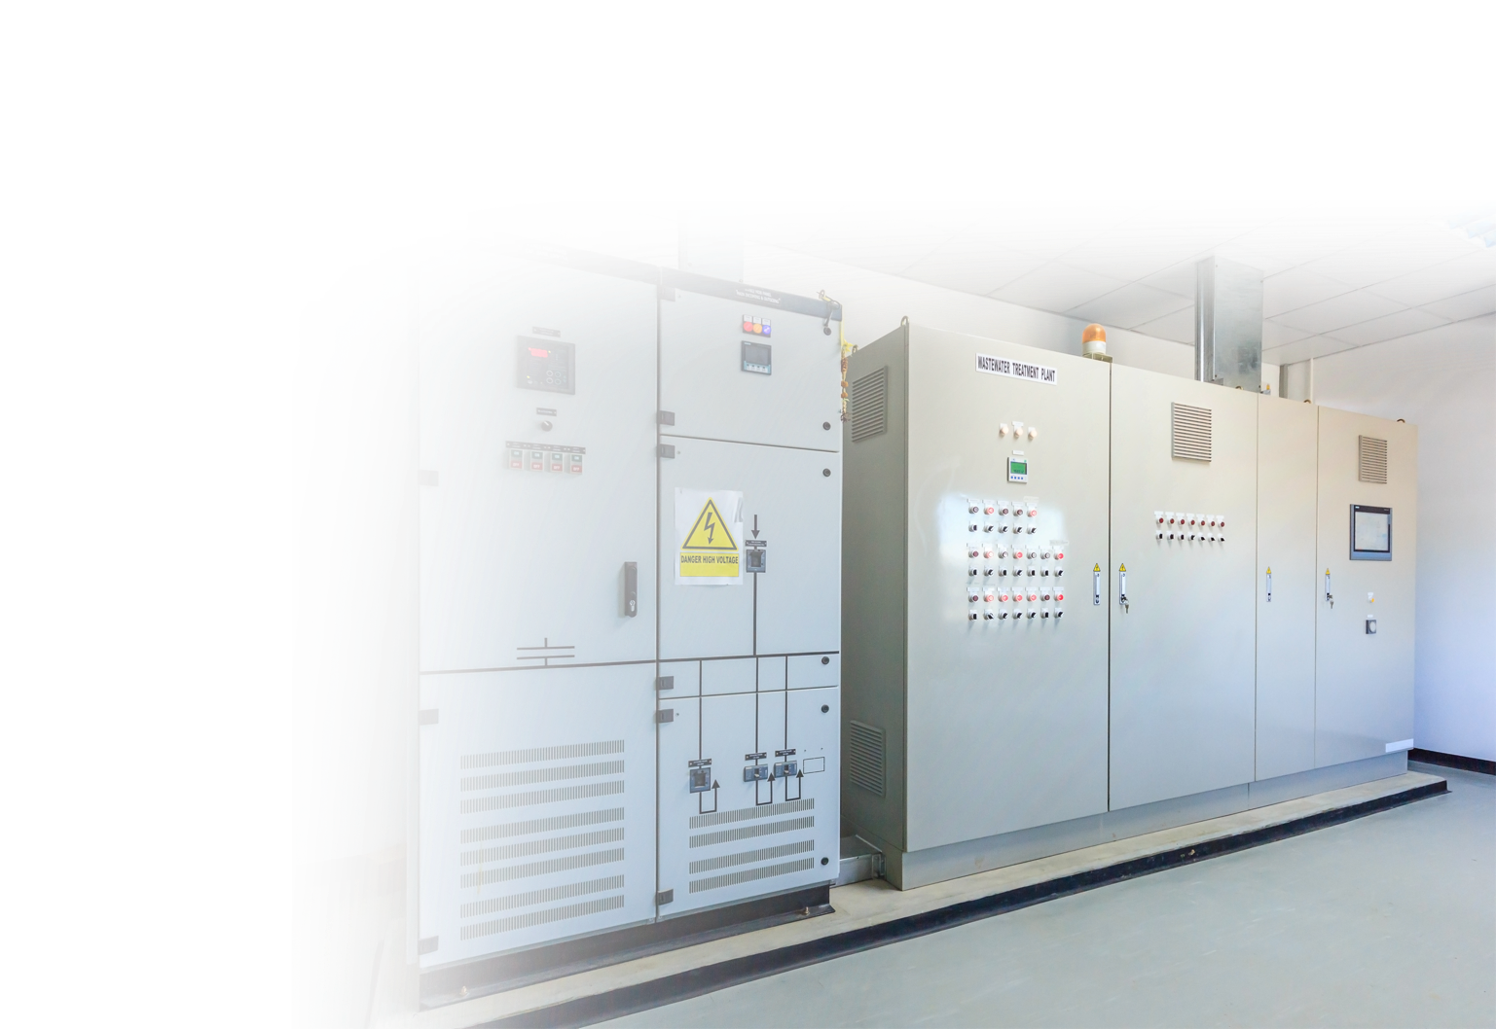
Protection for Odor Control System Switchgear
Motor and Pump
Bluetooth Enabled Overload Relay
Enhanced Overload Relay
Voltage Monitors
UL Class Fuses
LF Series Blocks & Covers
Safety
Notification
Arc-Flash Protection
Ground-Fault Relays
Flashers

Slide 12
Fuses, Blocks, Holders

Slide 13
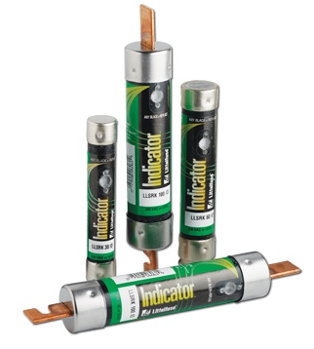
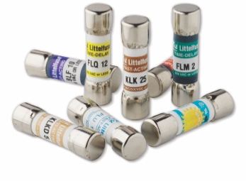
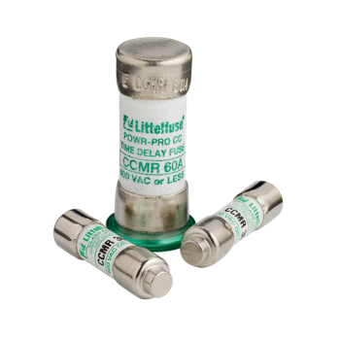
UL Power Fuses
Littelfuse UL-listed fuses protect your system from overload and high overcurrent. Littelfuse fuses are selected over breakers due to their higher interrupting ratings, quicker response time, easy coordination, and no calibration required.
Indicating and non-indicating versions
Engineered to maximize longevity and minimize opening times
High short-circuit current rating (SCCR)
Littelfuse 10x38mm midget and Class CC fuses help provide supplemental overcurrent protection and have the capability to limit currents with fast-acting reliability.
Saves 45-75% footprint space compared to Class R and Class J designs
Available in Time-Delay and Fast-Acting designs
High interrupting ratings available
Class CC Fuses are extremely current-limiting

Slide 14
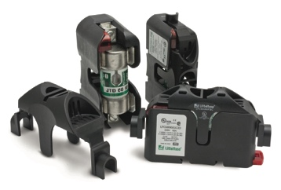
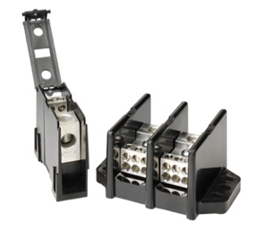
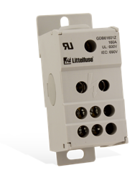
Fuse Blocks, Holders, Power Distribution Blocks
Fuse Blocks & Holders
Enable easy fuse installation and replacement with fuse blocks, fuse holders, and fuse accessories.
Compact design provides space savings
Universal and DIN rail mounting with optional DIN-clip covers
Indication available
Snap-to-release, no tools required
Power Distribution Blocks
Specially designed covers provide protection against accidental shorting between poles caused by loose wires, tools, or other conductive material. Also protects personnel from accidentally contacting energized connectors.
Meets UL standards
Space-saving designs
Integrated touch-safe cover to increase safety
Mounts to DIN rail or panels

Slide 15
Timers

Slide 16
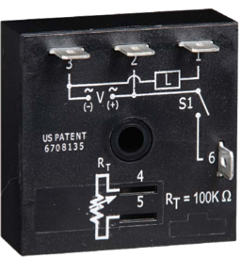
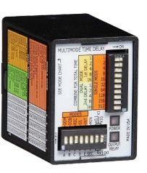
Time Delay Relays
Regulate the timing of pump controls; such as, delaying the restart of pumps after a power loss.
Prevents rapid recycling of pumps
Encapsulated to protect against shock, vibration and humidity
Multifunction model replaces thousands of competitive models

Slide 17
Ground-Fault Protection

Slide 18
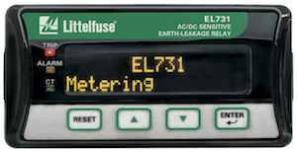
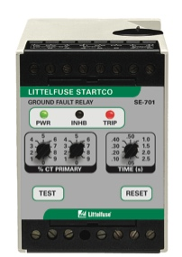
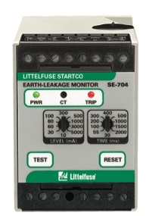
Ground-Fault Relays
Sensitive ground-fault relays featuring advanced filtering will quickly and reliably detect the breakdown of insulation resistance caused by moisture, vibration, chemicals or dust without nuisance tripping.
Microprocessor-based solutions with advanced digital harmonic filtering to prevent nuisance trips
Non-volatile trip memory retains trip state when on loss of power control to simplify troubleshooting
Complete and sensitive protection of VFDs to catch high-resistance ground faults before they escalate, from DC (0 Hz) to 6000 Hz
SE-704 Series features 10 mA trip level to meet code requirements
Connect to the IoT with multiple network communications options available

Slide 19

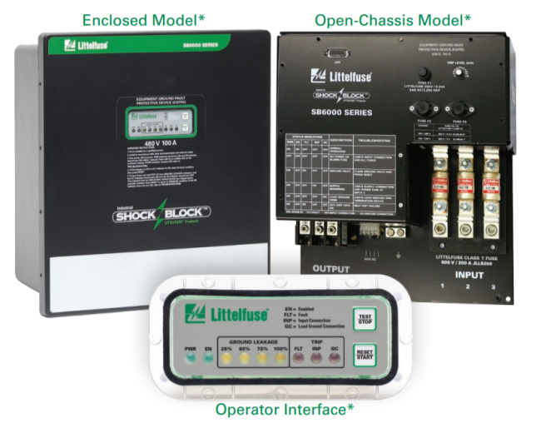
Industrial Ground-Fault Circuit Interrupter
Littelfuse Industrial Shock Block®
The first and only special-purpose GFCI that meets UL 943C Class C and Class D for personnel protection.
Includes line-side fusing
Leakage current metering
Ground-conductor monitoring
Automatic self-test and manual test button
Open or enclosed models
208V to 600V
Fixed (GFCI) or adjustable (EGFPD) Trip setting
Alternative to Assured Grounding
Littelfuse.com/ShockProtection

Slide 20
Arc-Flash Protection

Slide 21
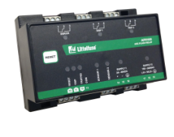

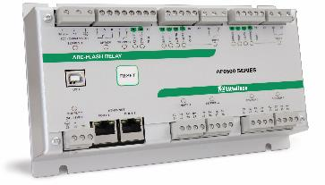

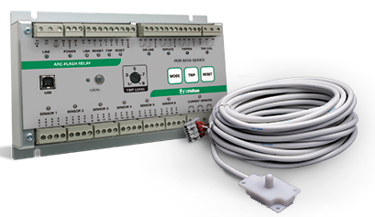
Arc-Flash Relays Increase Safety and
Protect Equipment
New!
AF0100
Uses light instead of current to detect the arc without worrying about coordination, inrush, and other sources of temporary overcurrent
Detect and trip very quickly (typically <1ms)
Reduce incident energy levels
Make facilities safer and reduce damage from arc faults
Satisfies NFPA 70E 2018: always active arc protection solution reduces human error
AF0500
PGR-8800
Littelfuse.com/ArcFlash

Slide 22
Motor Protection

Slide 23
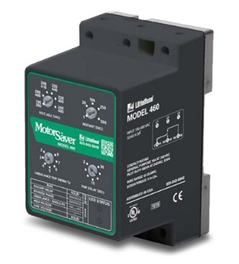
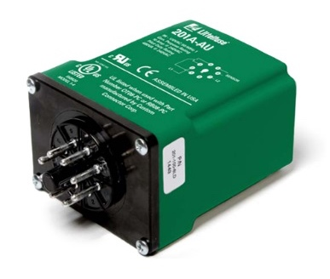
Basic Motor Protection
How Is It Used? | How Is It Good?
In addition to an overload relay to inexpensively enhance the motor protection | Cost effective option; protects 3-phase motors from: Over/under voltage Phase loss Reverse phase Unbalanced voltage Rapid cycling Without protection, each of these faulty conditions can cause motor windings to overheat and burn motor insulation which can cause premature motor failure
Model 460
(DIN-rail or surface mount)
Model 201A-AU
(8-pin socket mount)
Notes:
> Increase font size

Slide 24
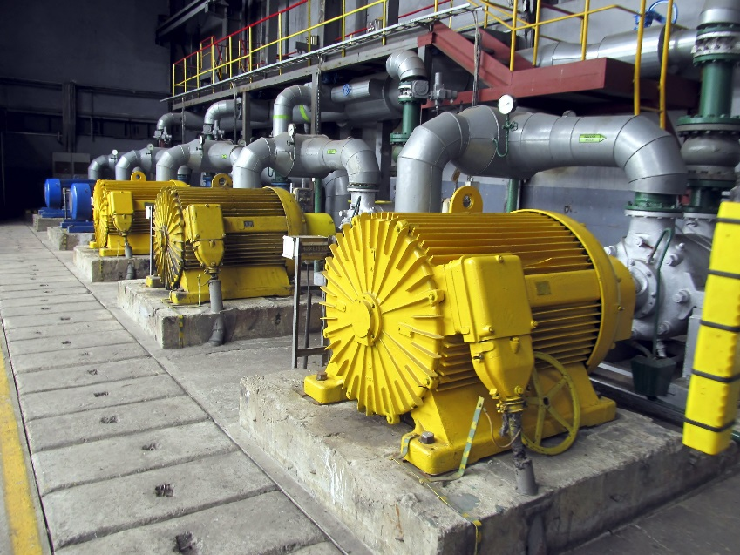
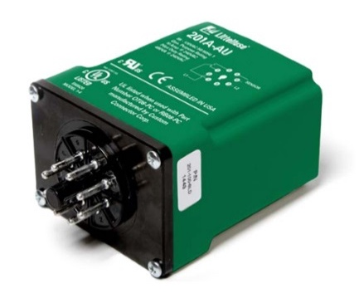
Field Success Story:
Upgrade protection to extend equipment life
~$80 Relay Saves $30,000 Motor
Phase-loss on 200 Hp motor
Protection relay 201A-AU installed
Prevented damage to motor during a phase-loss event
Saved $30,000 replacement costs of motor
Prevented operation from going offline

Slide 25
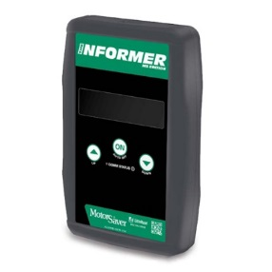
Standard Motor Protection
How Is It Used? | How Is It Better?
In addition to an overload relay to inexpensively enhance the motor protection | Provides second set of voltage inputs for monitoring voltage on the load-side of the motor contactor to detect contact failure Keeps history of past 20 fault causes including voltages and unbalance at the time of trip With optional Informer-MS, can wirelessly download and view fault history, read real-time voltages per phase, voltage unbalance and more
Model 455
Informer MS
Notes:
> Increase font size

Slide 26
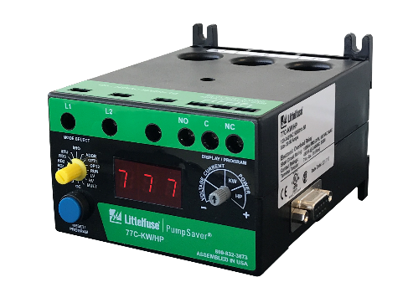
Advanced Motor Protection
How Is It Used? | How Is It Best?
Complete protection from overloads, underloads, current unbalance, voltage and phase | Pre-motor start protection Overload protection for any trip class, any size motor up to 600 Hp, 200-600V Optional comms to DCS/SCADA/HMI via Modbus over 485 or Ethernet, DeviceNet Display for real time voltage/current, trip cause, programming settings
Model 777 Enhanced Overload Relay
Notes:
> Increase font size

Slide 27
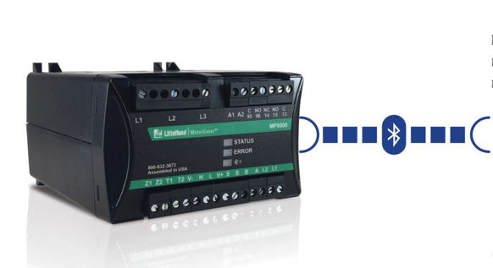
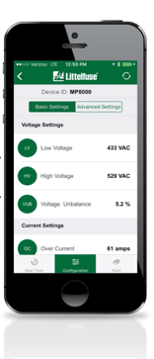
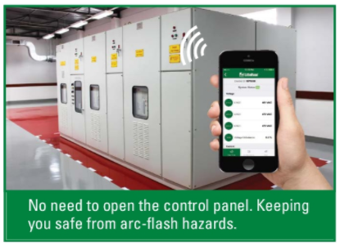


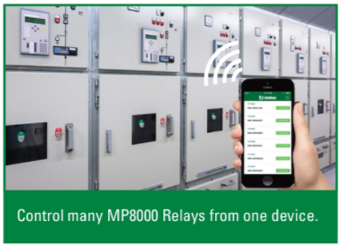

Smart Motor Protection
MP8000 Bluetooth® Overload Relay
Bluetooth® connectivity lets you stand next to the motor or pump during set-up instead of the relay
Underpower protection for dry run pump protection
Universal: one model works with single or three-phase systems, 90-690 VAC (and medium voltage via PTs), 0.5 – 100 amps directly (above 100A via CTs)
Notes:
> Increase font size

Slide 28
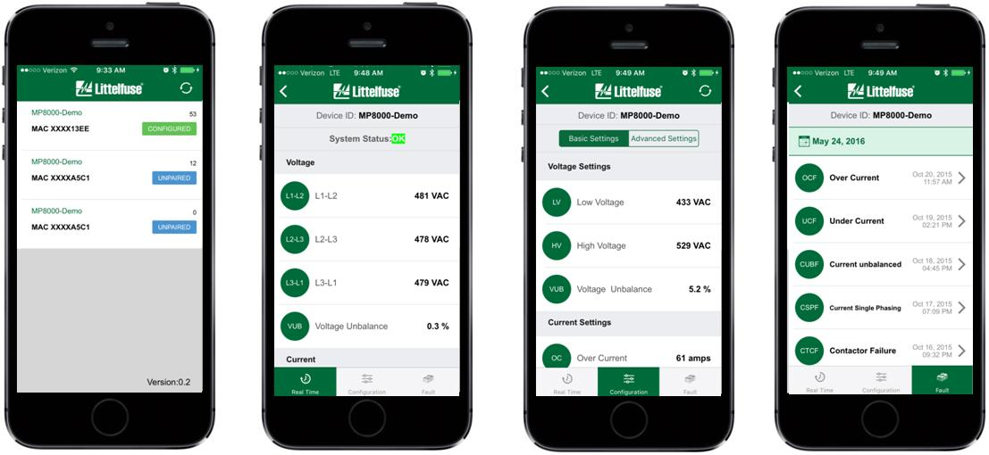
MP8000: App For Phone Or Tablet
Locate/Connect
Real time information
Setup/Settings
Fault History
Each Has Unique Pairing Code
V, I, KW, Unbalance % & More
Password Required To Change Settings
Date/Time Stamped

Slide 29
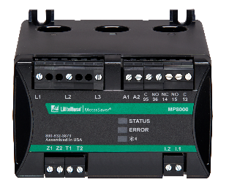
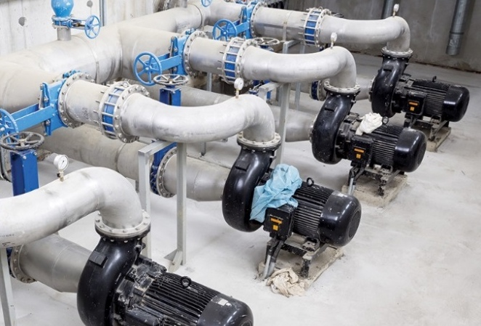
Field Success Story:
Upgrade protection to improve worker safety
Municipal Water Wells
Situation: Workers opened the panels and manually connected test equipment to record voltage and current readings by hand on their 250Hp motors.
Outcome: Installing MP8000 Bluetooth® Overload Relays helped them:
Record and time stamp their data improving accuracy
Improved safety from arc-flash by keeping workers out of the panel
Saved time by quickly getting data at once on their smartphone and not having to connect test equipment

Slide 30


Advanced Motor Protection
MPU-32
  Current/Phase Protection
  12 Protective Functions
  RTD or PTC input or up to 24 RTD inputs via MPS-RTD module(s)
  Network Communications
  Free PC Software, Easier To Program Than Competitors
MPS
  Voltage/Current/Phase Protection
  22 Protective Functions
  Up to 24 RTDs via MPS-RTD module(s)
  Network Communications
  Free PC Software, Easier To Program Than Competitors

Slide 31

Industrial Controls
Motor run capacitors, also known as start capacitors, are engineered to boost the current or reduce the power factor to an electrical motor. Capacitors are available with single and dual rated values, as well as round or oval case options.
Designed and manufactured in accordance with UL 810 and EIA standard RS-456
Features an aluminum oil filled construction
Testing and validation done in-house
Littelfuse offers transformers engineered to change one ac voltage to another by magnetic induction. These heavy-duty transformers are available with primary and secondary voltages between 20 to
500 VA.
Effectively “steps down” or isolates incoming voltage to improve efficiency
UL/CUL recognized 5085

Slide 32

Easy to Find Online Resources
Visit Littelfuse.com/water to access the following:
Product Datasheet Links
Video Overview
Capability Brochure
Relay and Fuse Catalogs
Product Specifications
Application Information

Slide 33

GLOBAL FOOTPRINT
Americas
Europe
Asia
Chicago, Illinois, USA (S)
Fremont, California, USA (RD, M)
Long Beach, California, USA (RD, M)
Milpitas, California, USA (RD, M)
Meridian, Idaho, USA (S)
Champaign, Illinois, USA (RD)
Mount Prospect, Illinois, USA (RD)
Beverly, Massachusetts, USA (RD, M)
Troy, Michigan, USA (S)
Rapid City, South Dakota, USA (RD)
Allen, Texas, USA (M)
Rock Falls, Illinois, USA (S, RD, M)
Round Rock, Texas, USA (RD, M)
Madison, Wisconsin, USA (S, RD)
Manaus, Brazil (S)
São Paulo, Brazil (S)
Saskatoon, Canada (S, RD)
Hermosillo, Mexico (S)
Matamoros, Mexico (M)
Muzquiz, Mexico (M)
Piedras Negras, Mexico (RD, M)
Bremen, Germany (S, RD)
Essen, Germany (S)
Lampertheim, Germany (RD, M)
Lauf, Germany (S)
Legnago, Italy (RD, M)
Kaunas, Lithuania (S, RD, M)
Amsterdam, Netherlands (S)
Deventer, Netherlands (S)
Leiden, Netherlands (S)
Charneca de Caparica, Portugal (M)
San Sebastian, Spain (RD)
Chippenham, United Kingdom (RD, M)
Beijing, China (S)
Chu-Pei, Taiwan, China (RD)
Dongguan, China (RD, M)
Hong Kong, China (S)
Kunshan, China (RD, M)
Shanghai, China (S, RD, M)
Shenzhen, China (S)
Suzhou, China (S, RD, M)
Taipei, Taiwan, China (S)
Wuxi, China (RD, M)
Tokyo, Japan (S)
Tsukuba, Japan (RD, M)
Noida, India (S)
Seongnam, South Korea (S)
Seoul, South Korea (S)
Lipa City, Philippines (RD, M)
Taguig City, Philippines (M)
Singapore (S)
S–Sales / Marketing
RD–Research & Development
M–Manufacturing

Slide 34

For More Information
Littelfuse.com/Water
1-800-TEC-FUSE
techline@littelfuse.com

